Slide 1



离散数学（011122）
魏可佶 kejiwei@tongji.edu.cn
https://kejiwei.github.io/

Slide 2
Chapter 4：Relations
4.1 Definition and Representation of Relations
4.2 Relational Operations
4.3 Properties of Relations
4.4 Equivalence Relations and Partial Order Relations
Notes:
4.1 关系的定义及其表示
4.2 关系运算
4.3 关系的性质
4.4 等价关系与偏序关系

Slide 3
4.1 Definition and Representation of Relations
4.1.1 Ordered Pairs and Cartesian Product
4.1.2 Definition of Binary Relations
4.1.3 Representation of Binary Relations
Notes:
4.1.1 有序对与笛卡儿积
4.1.2 二元关系的定义
4.1.3 二元关系的表示

Slide 4

4.1 Definition and Representation of Relations
⤷ 4.1.1 Ordered Pairs and Cartesian Product
Definition 4.1- Ordered Pairs A pair of elements x and y arranged in a specific order is called an ordered pair (or sequence), denoted as ⟨x,y⟩
Example: The Cartesian coordinates of a point: (3,−4)
Properties of Ordered Pairs
Order <x,y>≠<y,x> （when x≠ y）
The necessary and sufficient condition for <x,y>=<u,v> is <x,y>=<u,v> ⇔ x=u ∧ y=v
Example： <2,x+5>=<3y−4,y>，solve x, y.
Solve：3y−4=2, x+5=y ⇒ y=2, x= −3
Notes:
定义4.1 由两个元素x和y按照一定的顺序
组成的二元组称为有序对（序偶），记作 <x,y>
实例：点的直角坐标 (3,−4)
有序对的性质
有序性 <x,y>≠<y,x> （当x≠ y时）
<x,y>与<u,v>相等的充分必要条件是
<x,y>=<u,v> ⇔ x=u ∧ y=v
例1 <2,x+5>=<3y−4,y>，求 x, y.
解 3y−4=2, x+5=y ⇒ y=2, x= −3

Slide 5
4.1 Definition and Representation of Relations
⤷ 4.1.1 Ordered Pairs and Cartesian Product • Cartesian Product
Definition 4.2- Cartesian product
Let A and B be sets, the Cartesian product of A and B is denoted as A×B,
A×B = { <x,y> | x∈A ∧ y∈B }.
Example： A={0, 1}, B={a, b, c}
A×B={<0,a>,<0,b>,<0,c>,<1,a>,<1,b>,<1,c>}
B×A ={<a,0>,<b,0>,<c,0>,<a,1>,<b,1>,<c,1>}
Notes:
∅ 是一个完全空的集合，而 {∅} 是一个包含一个元素（即空集）的集合。
定义4.2 设A, B为集合，A与B 的笛卡儿积记作A×B，
A×B = { <x,y> | x∈A ∧ y∈B }.
例2 A={0, 1}, B={a, b, c}
A×B={<0,a>,<0,b>,<0,c>,<1,a>,<1,b>,<1,c>}
B×A ={<a,0>,<b,0>,<c,0>,<a,1>,<b,1>,<c,1>}

Slide 6
4.1.1 Ordered Pairs and Cartesian Product
⤷ Properties of the Cartesian Product
Empty Set Interaction：If either A or B is an empty set, then A×B is the empty set. A×∅=∅×B=∅
Not suitable for the commutative property：
A×B≠B×A (A≠B, A≠∅, B≠∅)
Not suitable for the associative property：
(A×B)×C≠A×(B×C) (A≠∅, B≠∅, C≠∅)
The union and intersection operations satisfy the distributive property.
A×(B∪C)=(A×B)∪(A×C)
(B∪C)×A=(B×A)∪(C×A)
A×(B∩C)=(A×B)∩(A×C)
(B∩C)×A=(B×A)∩(C×A)
‌Cardinality Multiplication Property：
If |A|=m, |B|=n, then |A×B|=mn
Notes:
不满足结合律 而三元有序对是用二元有序对定义的，即<a，b，c>=<<a，b>，c>={<a，b>，{<a，b>，c}}。继续展开就能得到集合的形式。
若A或B中有一个为空集，则A×B就是空集.

Slide 7
4.1.1 Ordered Pairs and Cartesian Product
⤷ n-dimensional Cartesian product
Definition 4.3：n-dimensional Cartesian product (1) An ordered n-tuple is formed by arranging n elements x₁,x₂,…, ​ in a specific order, denoted as ⟨x₁,x₂,…, x_{n}⟩ (2) Let A₁,A₂,…, be sets., Then the Cartesian product A₁×A₂×⋯×A_{n}={⟨x₁,x₂,…,x_{n}⟩∣x_{i}∈A_{i},_{i}=1,2,…,n} is called the n-dimensional（n-ary） Cartesian product.
Example： (1,1,0) is the Cartesian coordinate of a point in space, (1,1,0)∈R×R×R(1, 1, 0).
Notes:
定义4.3
(1) 由 n 个元素 x₁, x₂, …, x_{n}按照一定的顺序排列构成
有序 n 元组，记作 <x₁, x₂, …, x_{n}>
(2) 设A₁, A₂, …, A_{n}为集合，称
A₁×A₂×…×A_{n}={<x₁, x₂, … , x_{n}> | x_{i}∈A_{i}, i=1,2, …,n}
为 n 阶笛卡儿积.
实例
(1,1,0)为空间直角坐标，(1,1,0)∈R ×R ×R

Slide 8


4.1 Definition and Representation of Relations
⤷ 4.1.2 Definition of Binary Relations
Definition 4.4- Binary Relations A set is called a binary relation, denoted as R, if it satisfies one of the following conditions: (1) The set is non-empty, and its elements are ordered pairs. (2) The set is empty.
For example, if ⟨x,y⟩∈R, it can be written as x R y; if ⟨x,y⟩∉R, it can be written as x y
Example: R={⟨1,2⟩,⟨a,b⟩}, S={⟨1,2⟩,a,b}
R is a binary relation, but S is not a binary relation because a and b are not ordered pairs.
Using the above notation, we can write 1R2, aRb, a c, etc.
Notes:
当a, b不是有序对时，S不是二元关系
定义4.4
如果一个集合满足以下条件之一：
（1）集合非空, 且它的元素都是有序对
（2）集合是空集
则称该集合为一个二元关系, 简称为关系，记作R.
如<x,y>∈R, 可记作 xRy；如果<x,y>∉R, 则记作x y
实例：R={<1,2>,<a,b>}, S={<1,2>,a,b}.
R是二元关系, 当a, b不是有序对时，S不是二元关系
根据上面的记法，可以写1R2, aRb, a c等.

Slide 9
4.1 Definition and Representation of Relations
⤷ 4.1.2 Definition of Binary Relations（e.g.）
Example:
(1) R={<x,y> | x,y∈N, x+y<3}
={<0,0>, <0,1>, <0,2>, <1,0>, <1,1>, <2,0>}
(2) C={<x,y> | x,y∈R, x²+y²=1}，
Where R represents the set of real numbers, C is the relation between the horizontal and vertical coordinates of points in the Cartesian coordinate plane, and all points in C exactly form the unit circle in the coordinate plane.
(3) R={<x,y,z> | x,y,z∈R, x+2y+z=3}，
R represents a plane in the 3D Cartesian coordinate system.
Notes:
例3
(1) R={<x,y> | x,y∈N, x+y<3}
={<0,0>, <0,1>, <0,2>, <1,0>, <1,1>, <2,0>}
(2) C={<x,y> | x,y∈R, x²+y²=1}，其中R代表实数集合，
C是直角坐标平面上点的横、纵坐标之间的关系，
C中的所有的点恰好构成坐标平面上的单位圆.
(3) R={<x,y,z> | x,y,z∈R, x+2y+z=3}，
R代表了空间直角坐标系中的一个平面.

Slide 10
4.1 Definition and Representation of Relations
⤷ 4.1.2 Definition of Binary Relations（e.g.）
The employee payroll (relation) is a set of 5-tuples representing
employees:<301,B,25,M,19000>,<302,O,23,F,18500>
ID No. | Name | Age | Gender | Salary
301 302 303 304 … | B O Y M … | 25 23 37 31 … | M F M M … | 19000 18500 25000 22000 …
Notes:
在关系数据库理论中，表（或称为关系）是由这样的n元组的集合组成的，每个n元组代表表中的一行，是一个记录。表的每一列代表一个特定的字段，而每一行则是一个记录，反映了这些字段的具体值。
员工工资表（关系）是员工的5元组的集合：
<301,柏林,25,男,19000>，<302,欧阳云,23,女,18500>

Slide 11
4.1.2 Definition of Binary Relations
⤷ Binary relation from A to B & Binary relation on A
Definition 4.5 Let A and B be sets. Any subset of A×B that defines a binary relation is called a binary relation from A to B. When A=B, it is called a binary relation on A.
Counting:
∣A∣=n,∣B∣=m,∣A×B∣=nm, and there are 2^{nm} subsets of A×B. Therefore, there are 2^{nm} different binary relations from A to B.
If ∣A∣=n, there are different binary relations on A.
For example, if ∣A∣=3, then there are 512 different binary relations on A.
Note: Sets are the ‌static carriers‌ of relations, while relations are the ‌dynamic interaction rules‌ between sets.
Notes:
集合是关系的静态载体，关系是集合的动态交互规则‌
可以在也可以不在所以2^nm
定义4.5 设A,B为集合, A×B的任何子集所定义的二元关系叫做从 A 到 B 的二元关系, 当 A=B 时则叫做 A上的二元关系.
计数：
|A|=n, |B|=m, |A×B|=nm, A×B 的子集有 个. 所以从A到B有 个不同的二元关系. |A|=n, A上有 不同的二元关系.
例如 |A|=3, 则 A上有512个不同的二元关系.

Slide 12
4.1.2 Definition of Binary Relations
⤷ universal relation(E_{A}) & identity relation (I_{A})
Let A be any set.The empty set ∅ is considered as the empty relation on A.
Definition 4.6:
E_{A} is called the universal relation on A, where
E_{A}={<x,y> | x∈A ∧y∈A}=A×A
I_{A} is called the identity relation on A, where I_{A}={<x,x> | x∈A}
Example: A={1,2}, then E_{A}={<1,1>,<1,2>,<2,1>,<2,2>} I_{A}={<1,1>,<2,2>}
Notes:
设A为任意集合，
∅是A上的关系，称为空关系
定义 4.6 E_{A}, I_{A}分别称为全域关系与恒等关系，其中
E_{A}={<x,y> | x∈A ∧y∈A}=A×A I_{A}={<x,x> | x∈A}
例如 A={1,2}, 则 E_{A}={<1,1>,<1,2>,<2,1>,<2,2>} I_{A}={<1,1>,<2,2>}

Slide 13
4.1.2 Definition of Binary Relations •Less than or equal to relation(L_{A}) ,
Divides relation(D_{B}),Containment relation(R⊆)
Definition 4.7:
The less than or equal to relation L_{A}, the divides relation D_{B}, and the containment relation R⊆ are defined as follows:
L_{A}={<x,y>| x,y∈A∧x≤y}, A⊆R, R is the set of real numbers.
D_{B}={<x,y>| x,y∈B∧x divides y}, B⊆Z*, Z* is the set of non-zero integers.
R⊆={<x,y>| x,y∈A∧x⊆y}, where A is a family of sets.
Example: A={1,2,3}, B={a,b}, then L_{A}={<1,1>,<1,2>,<1,3>,<2,2>,<2,3>,<3,3>} D_{A}={<1,1>,<1,2>,<1,3>,<2,2>,<3,3>}
Notes:
集合族是一些集合的集合。换句话说，它是一个更高层次的集合，其元素本身都是集合。
定义4.7 ：
小于等于关系L_{A}, 整除关系D_{A}, 包含关系R⊆定义如下：
L_{A}={<x,y>| x,y∈A∧x≤y}, 这里A⊆R, R为实数集合
D_{B}={<x,y>| x,y∈B∧x整除y}, B⊆Z*, Z*为非0整数集
R⊆={<x,y>| x,y∈A∧x⊆y}, 这里A是集合族

Slide 14
4.1.2 Definition of Binary Relations •Less than or equal to relation(L_{A}) ,
Divides relation(D_{B}),Containment relation(R⊆)
Example: B={a,b}, A=P(B)={∅,{a},{b},{a,b}},
then the inclusion relation on A is : R⊆={<∅,∅>,<∅,{a}>,<∅,{b}>,<∅,{a,b}>,<{a},{a}>,
<{a},{a,b}>,<{b},{b}>,<{b},{a,b}>,<{a,b},{a,b}>}
Similarly, greater than or equal to relations, less than relations, greater than relations, proper inclusion relations, etc., can also be defined.
Notes:
集合族是一些集合的集合。换句话说，它是一个更高层次的集合，其元素本身都是集合。
定义4.7 ：
小于等于关系L_{A}, 整除关系D_{A}, 包含关系R⊆定义如下：
L_{A}={<x,y>| x,y∈A∧x≤y}, 这里A⊆R, R为实数集合
D_{B}={<x,y>| x,y∈B∧x整除y}, B⊆Z*, Z*为非0整数集
R⊆={<x,y>| x,y∈A∧x⊆y}, 这里A是集合族

Slide 15
4.1.3 Representation of Binary Relations
⤷Relational Matrix & Relational Graph
Ways to Represent Relations:
Set-theoretic expression of relations; Relational matrix; Relational graph
Definition 4.8: Relational Matrix
If A={x₁, x₂, …, x_{m}} and B={y₁, y₂, …, y_{n}} and R is a relation from A to B, then the relational matrix of R is the Boolean matrix M_{R} = [r_{ij}]_{m× n} , where
r_{ij} = 1⇔ < x_{i}, y_{j}> ∈R.
Definition 4.9: Relational Graph
If A= {x₁, x₂, …, x_{m}}，and R is a relation on A，the relational graph of R is G_{R}=<A, R>, where A is the set of vertices and R is the set of edges. If <x_{i},x_{j}> belongs to R，there is a directed edge from x_{i} to x_{j} in the graph.
Notes:
关系的表示方式：关系的集合表达式、关系矩阵、关系图
定义4.8 关系矩阵 若A={x₁, x₂, …, x_{m}}，B={y₁, y₂, …, y_{n}}，R是从A到B的关系，R的关系矩阵是布尔矩阵M_{R} = [ r_{ij} ] _{m×n}, 其中 r_{ij} = 1⇔ < x_{i}, y_{j}> ∈R.
定义4.9 关系图 若A= {x₁, x₂, …, x_{m}}，R是从A上的关系，R的关系图是G_{R}=<A, R>, 其中A为结点集，R为边集.如果<x_{i},x_{j}>属于关系R，在图中就有一条从 x_{i} 到 x_{j} 的有向边.
注意：设A, B为有穷集
关系矩阵适合于表示从A到B 的关系或者A上的关系
关系图适合于表示A上的关系

Slide 16

4.1.3 Representation of Binary Relations
⤷Relational Matrix & Relational Graph
Note: Let A and B be finite sets.
Relational matrices are suitable for representing relations from A to B or relations on A.
Relational graphs are suitable for representing relations on A.
Example: A={a, b, c, d}, R={<a, a>,<a, b>,<a, c>,<b, a>,<d, b>},
The relationship matrix M_{R} and the relationship graph G_{R}
$M_{R}=\left[\begin{matrix}1 & 1 & 1 & 0 \\ 1 & 0 & 0 & 0 \\ 0 & 0 & 0 & 0 \\ 0 & 0 & 0 & 1\end{matrix}\right]$
Notes:
关系的表示方式：关系的集合表达式、关系矩阵、关系图
定义4.8 关系矩阵 若A={x₁, x₂, …, x_{m}}，B={y₁, y₂, …, y_{n}}，R是从A到B的关系，R的关系矩阵是布尔矩阵M_{R} = [ r_{ij} ] _{m×n}, 其中 r_{ij} = 1⇔ < x_{i}, y_{j}> ∈R.
定义4.9 关系图 若A= {x₁, x₂, …, x_{m}}，R是从A上的关系，R的关系图是G_{R}=<A, R>, 其中A为结点集，R为边集.如果<x_{i},x_{j}>属于关系R，在图中就有一条从 x_{i} 到 x_{j} 的有向边.
注意：设A, B为有穷集
关系矩阵适合于表示从A到B 的关系或者A上的关系
关系图适合于表示A上的关系

Slide 17
4.1 Definition and Representation of Relations • Brief summary
Objective :
Key Concepts ：

Slide 18
离散数学（011122）
魏可佶 kejiwei@tongji.edu.cn
https://kejiwei.github.io/

Slide 19
Chapter 4：Relations
4.1 Definition and Representation of Relations
4.2 Relational Operations
4.3 Properties of Relations
4.4 Equivalence Relations and Partial Order Relations
Notes:
4.1 关系的定义及其表示
4.2 关系运算
4.3 关系的性质
4.4 等价关系与偏序关系

Slide 20
4.2 Relational Operation
4.2.1 Basic Operations of Relations
Domain, range, domain (again), inverse, composition
Properties of basic operations
4.2.2 Power Operations of Relations
Definition of power operations
Methods of power operations
Properties of power operations
Notes:
4.2.1 关系的基本运算
定义域、值域、域、逆、合成
基本运算的性质
4.2.2 关系的幂运算
幂运算的定义
幂运算的方法
幂运算的性质

Slide 21
4.2.1 Basic Operations of Relations
⤷ Domain, Range, and Field
Definition 4.10: Domain, Range, and Field domR = {x | ∃y (<x,y>∈R) }
ranR = {y | ∃x (<x,y>∈R) }
fldR = domR ∪ ranR
Example:
R= {<a,{b}>,<c,d>,<{a},{d}>,<d,{d}>}, then
domR =
ranR =
fldR =
{ a, c, {a}, d }
{{b}, d, {d}}
{a, c, {a}, d, {b}, {d}}
Notes:
range (or sometimes called the codomain)
In relational operations, the term field is typically not directly used in the context of relations themselves. However, in algebraic contexts, a field refers to an algebraic structure with operations of addition and multiplication that satisfy certain properties (such as closure, existence of additive and multiplicative inverses, etc.).
翻译英文：定义4.10 定义域、值域 和 域 domR = {x | y (<x,y>R) } ranR = {y | x (<x,y>R) } fldR = domR  ranR

Slide 22
4.2.1 Basic Operations of Relations
⤷ Inverse and Composition of Relations
Definition 4.11: The inverse of R
R⁻¹ = {<y,x> | <x,y>∈R}
Definition 4.12: Composition of R and S
R∘S = |<x,z> | ∃ y (<x,y>∈R∧<y,z>∈S) }
Example：R={<1,2>, <2,3>, <1,4>, <2,2>}
S={<1,1>, <1,3>, <2,3>, <3,2>, <3,3>}
R⁻¹ =
R∘S =
S∘R =
{<2,1>, <3,2>, <4,1>,<2,2>}
{<1,3>, <2,2>, <2,3> }
{<1,2>, <1,4>, <3,2>, <3,3>}
Notes:
定义4.11 R 的逆
R⁻¹ = {<y,x> | <x,y>∈R}
定义4.12 R与S的合成
R∘S = |<x,z> | ∃ y (<x,y>∈R∧<y,z>∈S)

Slide 23
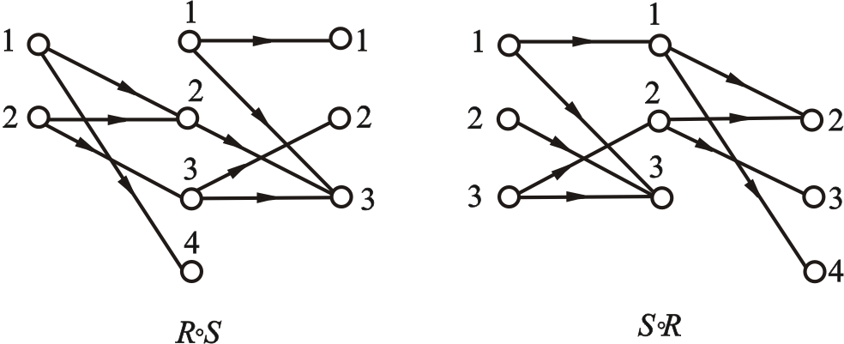
4.2.1 Basic Operations of Relations
⤷ Find the composition using a diagram
Use the diagrammatic (not relational diagram) method to find the composition.
Example：R={<1,2>, <2,3>, <1,4>, <2,2>}
S={<1,1>, <1,3>, <2,3>, <3,2>, <3,3>}
R∘S ={<1,3>, <2,2>, <2,3>}
S∘R ={<1,2>, <1,4>, <3,2>, <3,3>}
Notes:
利用图示（不是关系图）方法求合成

Slide 24
4.2.1 Basic Operations of Relations
⤷ Properties of Inverse Operations
Theorem 4.1：Let F be an arbitrary relation, then:
(1) (F⁻¹)⁻¹=F
(2) domF⁻¹=ranF, ranF⁻¹=domF
Proof：
For any <x, y>, by the definition of inverse, we have
<x, y>∈(F ⁻ ¹)⁻¹ ⇔ <y, x>∈F⁻¹ ⇔ <x, y>∈F
Thus, (F⁻¹)⁻¹=F
(2) For any x,
x∈domF⁻¹ ⇔ ∃y(<x, y>∈F⁻¹)
⇔ ∃y(<y, x>∈F) ⇔ x∈ranF Thus, domF⁻¹= ranF.
Similarly, we can prove ranF⁻¹ = domF.
Notes:
domR = {x | ∃y (<x,y>∈R) }
ranR = {y | ∃x (<x,y>∈R) }
R⁻¹ = {<y,x> | <x,y>∈R}
定理4.1 设F是任意的关系, 则
(1) (F⁻¹)⁻¹=F
(2) domF⁻¹=ranF, ranF⁻¹=domF
证
(1) 任取<x, y>, 由逆的定义有
<x, y>∈(F ⁻ ¹)⁻¹ ⇔ <y, x>∈F⁻¹ ⇔ <x, y>∈F
所以有 (F⁻¹)⁻¹=F
(2) 任取x,
x∈domF⁻¹ ⇔ ∃y(<x, y>∈F⁻¹)
⇔ ∃y(<y, x>∈F) ⇔ x∈ranF 所以有domF⁻¹= ranF. 同理可证 ranF⁻¹ = domF.

Slide 25
4.2.1 Basic Operations of Relations
⤷ Associativity and Inverse Operations of Relational Composition结合律
Theorem 4.2： Let F, G, and H be arbitrary relations, then:
(1) (F∘G)∘H=F∘(G∘H)
(2) (F∘G)⁻¹= G⁻¹∘F⁻¹
Proof (1) ：For any <x,y>,
<x, y>∈(F∘G)∘H
⇔ ∃t (<x, t>∈F∘G∧<t, y>∈H)
⇔ ∃t (∃s (<x, s>∈F∧<s, t>∈G)∧<t, y>∈H) ⇔ ∃t ∃s (<x, s>∈F∧<s, t>∈G∧<t, y>∈H) ⇔ ∃s (<x, s>∈F∧∃t (<s, t>∈G∧<t, y>∈H)) ⇔ ∃s (<x, s>∈F∧<s, y>∈G∘H) ⇔ <x, y>∈F∘(G∘H) Thus, (F∘G)∘H = F∘(G∘H)
Notes:
定理4.2 设F, G, H是任意的关系, 则
(1) (F∘G)∘H=F∘(G∘H)
(2) (F∘G)⁻¹= G⁻¹∘F⁻¹
证 (1) 任取<x,y>,
<x, y>∈(F∘G)∘H
⇔ ∃t (<x, t>∈F∘G∧<t, y>∈H)
⇔ ∃t (∃s (<x, s>∈F∧<s, t>∈G)∧<t, y>∈H) ⇔ ∃t ∃s (<x, s>∈F∧<s, t>∈G∧<t, y>∈H) ⇔ ∃s (<x, s>∈F∧∃t (<s, t>∈G∧<t, y>∈H)) ⇔ ∃s (<x, s>∈F∧<s, y>∈G∘H) ⇔ <x, y>∈F∘(G∘H) 所以 (F∘G)∘H = F∘(G∘H)

Slide 26
4.2.1 Basic Operations of Relations
⤷ Associativity and Inverse Operations of Relational Composition结合律
Theorem 4.2： Let F, G, and H be arbitrary relations, then:
(1) (F∘G)∘H=F∘(G∘H)
(2) (F∘G)⁻¹= G⁻¹∘F⁻¹
Proof (2)： For any <x, y>,
<x, y>∈(F∘G)⁻¹ ⇔ <y, x>∈F∘G ⇔ ∃t (<y, t>∈F∧(t, x)∈G) ⇔ ∃t (<x, t>∈G⁻¹∧(t, y)∈F⁻¹) ⇔ <x, y>∈G⁻¹∘F⁻¹
Thus (F∘G)⁻¹ = G⁻¹∘F⁻¹
Notes:
定理4.2 设F, G, H是任意的关系, 则
(1) (F∘G)∘H=F∘(G∘H)
(2) (F∘G)⁻¹= G⁻¹∘F⁻¹
证 (1) 任取<x,y>,
<x, y>∈(F∘G)∘H
⇔ ∃t (<x, t>∈F∘G∧<t, y>∈H)
⇔ ∃t (∃s (<x, s>∈F∧<s, t>∈G)∧<t, y>∈H) ⇔ ∃t ∃s (<x, s>∈F∧<s, t>∈G∧<t, y>∈H) ⇔ ∃s (<x, s>∈F∧∃t (<s, t>∈G∧<t, y>∈H)) ⇔ ∃s (<x, s>∈F∧<s, y>∈G∘H) ⇔ <x, y>∈F∘(G∘H) 所以 (F∘G)∘H = F∘(G∘H)

Slide 27
4.2.1 Basic Operations of Relations
⤷ Relational Composition of the Identity Relation I_{A}
Theorem 4.3： Composition of the Identity Relation I_{A} Let R be a relation on A, I_{A}​ is the Identity Relation on Set A then R∘I_{A}= I_{A}∘R = R
Proof For any pair <x, y> <x, y>∈R∘I_{A} ⇔ ∃t (<x, t>∈R∧<t, y>∈I_{A})
⇔ ∃t (<x, t>∈R∧t=y∧y∈A)
⇔ <x, y>∈R
Thus, R∘I_{A}=R.
Similarly, we can prove that I_{A}∘R=R.
Notes:
恒等关系 I_{A}={<x,x>|x∈A} 与R的合成运算，恒等关系在合成运算中起着“中性”或“不变”的作用。
对于任何a, b ∈ A，如果 (a, b) ∈ R，则必须有 (a, a) ∈ I_{A} 且 (a, b) ∈ R，根据合成的定义，这将导致 (a, b) ∈ I ∘ R，这证明了 I ∘ R = R。

Slide 28
4.2.2 Power Operations of Relations
⤷ n-th power of R（R^{n}）
Definition 4.13： R^{n} Let R be a relation on A, and n be a natural number. The n-th power of R is defined as:
(1) R⁰ = {<x,x> | x∈A } = I_{A}
(2) R^{n+1} = R^{n}∘R
Note:
For any relations R₁ and R₂ on A, we have,
R₁⁰ = R₂⁰ = I_{A}
For any relation R on A, we have: R¹ = R
Notes:
递归定义法：因为它将一个更高次幂的关系定义为前一次幂的关系与原始关系的合成。
定义4.13 设R为A上的关系, n为自然数, 则 R 的 n次幂是
(1) R⁰ = {<x,x> | x∈A } = I_{A}
(2) R^{n+1} = R^{n}∘R
注意：
对于A上的任何关系R₁和R₂都有
R₁⁰ = R₂⁰ = I_{A} 对于A上的任何关系 R 都有
R¹ = R

Slide 29
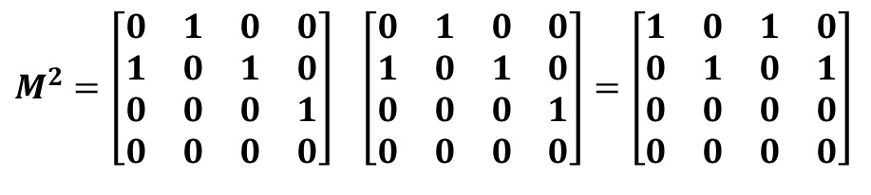

4.2.2 Power Operations of Relations
⤷ Methods of power operations • matrix multiplication
For a relation R represented by a set, computing R^{n} means the composition of R with itself n times.
The n-th power of a relation is equal to the n-th power of its matrix representation.
The matrix representation of a relation is obtained by matrix multiplication, where addition is performed using logical addition.
Example: Let A = {a, b, c, d}, R = {<a,b>,<b,a>,<b,c>,<c,d>},
Find the powers of R, and represent them using both a matrix and a relation diagram.
Solution: The relation matrix for R and R² are as follows:
$$M=\left[\begin{matrix}0 & 1 & 0 & 0 \\ 1 & 0 & 1 & 0 \\ 0 & 0 & 0 & 1 \\ 0 & 0 & 0 & 0\end{matrix}\right]$$
$$M^{2}=\left[\begin{matrix}0 & 1 & 0 & 0 \\ 1 & 0 & 1 & 0 \\ 0 & 0 & 0 & 1 \\ 0 & 0 & 0 & 0\end{matrix}\right] \left[\begin{matrix}0 & 1 & 0 & 0 \\ 1 & 0 & 1 & 0 \\ 0 & 0 & 0 & 1 \\ 0 & 0 & 0 & 0\end{matrix}\right]=\left[\begin{matrix}1 & 0 & 1 & 0 \\ 0 & 1 & 0 & 1 \\ 0 & 0 & 0 & 0 \\ 0 & 0 & 0 & 0\end{matrix}\right]$$
Notes:
对于集合表示的关系R，计算R^{n} 就是 n 个 R 合成 .
关系的n次幂等于其矩阵表示的n次幂
矩阵表示的关系就是矩阵相乘, 其中相加采用逻辑加.
例3 设A = {a, b, c, d}, R = {<a,b>,<b,a>,<b,c>,<c,d>},
求R的各次幂, 分别用矩阵和关系图表示.
解 R与R²的关系矩阵分别为
Why?
The reason R2=R4=R6=⋯R_2 = R_4 = R_6 = \cdotsR2​=R4​=R6​=⋯ and R3=R5=R7=⋯R_3 = R_5 = R_7 = \cdotsR3​=R5​=R7​=⋯ is because:
The transformation applied to go from Rn→Rn+1R_{n} \to R_{n+1}Rn​→Rn+1​ alternates between two fixed processes (e.g., composition and union).
These processes become stable after a certain point, meaning applying them again does not change the relation.

Slide 30

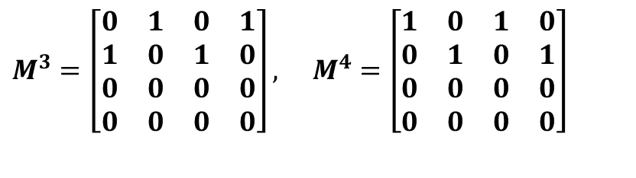
4.2.2 Power Operations of Relations
⤷ Methods of power operations • matrix multiplication
Example: Let A = {a, b, c, d}, R = {<a,b>,<b,a>,<b,c>,<c,d>},
Find the powers of R, and represent them using both a matrix and a relation diagram.
Solution: The relation matrix for R³ and R⁴ are as follows:
Thus: M⁴ = M², R⁴ = R². Then we can find R² = R⁴ = R⁶ = …, R³ = R⁵ = R⁷ = …
R⁰ = I_{A} relation matrix :
$$M^{3}=\left[\begin{matrix}0 & 1 & 0 & 1 \\ 1 & 0 & 1 & 0 \\ 0 & 0 & 0 & 0 \\ 0 & 0 & 0 & 0\end{matrix}\right], M^{4}=\left[\begin{matrix}1 & 0 & 1 & 0 \\ 0 & 1 & 0 & 1 \\ 0 & 0 & 0 & 0 \\ 0 & 0 & 0 & 0\end{matrix}\right]$$
$$M^{0}=\left[\begin{matrix}1 & 0 & 0 & 0 \\ 0 & 1 & 0 & 0 \\ 0 & 0 & 1 & 0 \\ 0 & 0 & 0 & 1\end{matrix}\right]$$
Notes:
对于集合表示的关系R，计算R^{n} 就是 n 个 R 合成 .
关系的n次幂等于其矩阵表示的n次幂
矩阵表示的关系就是矩阵相乘, 其中相加采用逻辑加.
例3 设A = {a, b, c, d}, R = {<a,b>,<b,a>,<b,c>,<c,d>},
求R的各次幂, 分别用矩阵和关系图表示.
解 R与R²的关系矩阵分别为
Which condition can be formed as that?

Slide 31
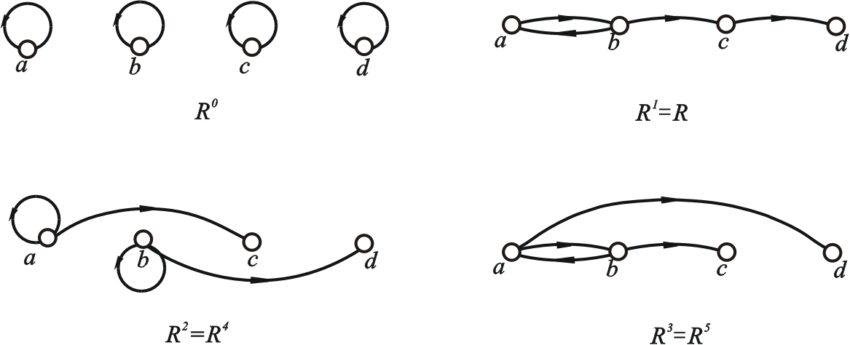
4.2.2 Power Operations of Relations
⤷ Methods of power operations • relation diagram
Let R be a relation on A = {a, b, c, d},
R = {<a,b>,<b,a>,<b,c>,<c,d>},
Using the relation diagram method, the relation diagrams for R⁰, R¹, R², R³
Notes:
用关系图的方法得到R⁰, R¹, R², R³,…的关系图如下图所示

Slide 32
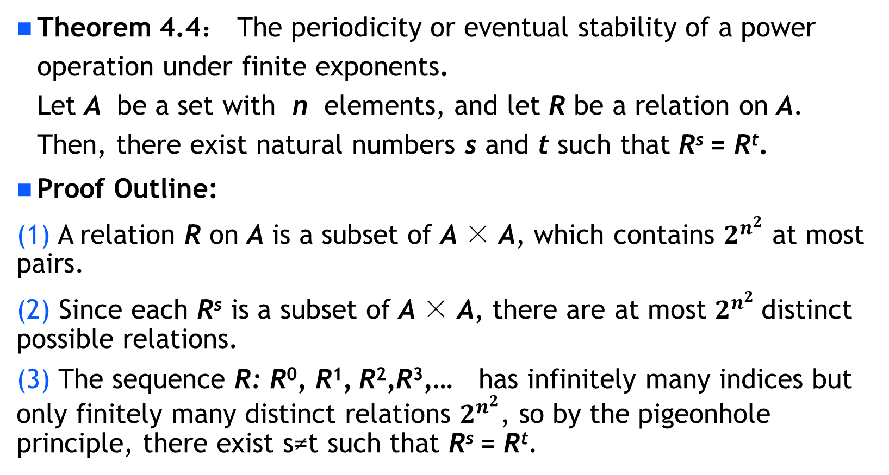
4.2.2 Power Operations of Relations •The properties of a power operations
⤷ periodicity or eventual stability
Theorem 4.4： The periodicity or eventual stability of a power operation under finite exponents. Let A be a set with n elements, and let R be a relation on A. Then, there exist natural numbers s and t such that R^{s} = R^{t}.
Proof Outline:
(1) A relation R on A is a subset of A × A, which contains $2^{n^{2}}$ at most pairs.
(2) Since each R^{s} is a subset of A × A, there are at most $2^{n^{2}}$distinct possible relations.
(3) The sequence R: R⁰, R¹, R²,R³,… has infinitely many indices but only finitely many distinct relations $2^{n^{2}}$, so by the pigeonhole principle, there exist s≠t such that R^{s} = R^{t}.
Notes:
定理4.4 设 A 为 n 元集, R是A上的关系, 则存在自然数 s 和 t, 使得 R^{s} = R^{t}.
证 R 为A上的关系, 由于|A| = n, A上的不同关系只有 个. 当列出 R 的各次幂
R⁰, R¹, R², …, , …,
必存在自然数 s 和 t 使得 R^{s} = R^{t}.

Slide 33
4.2.2 Power Operations of Relations •The properties of a power operations
⤷ Composition of Powers and Power of a Power properties
Theorem 4.5: Composition of Powers and Power of a Power properties. Let R be a relation on A , and m, n ∈ N, Then
(1) R^{m}∘R^{n} = R^{m+n} (2) (R^{m})^{n} = R^{mn}
Proof: By induction. (1) For any given m∈N, , we induct on n.
If n=0, then R^{m}∘R⁰ = R^{m}∘I_{A}= R^{m} = R^{m+0}
Assume R^{m}∘R^{n} = R^{m+n}, then R^{m}∘R^{n+1} = R^{m}∘(R^{n}∘R) = (R^{m}∘R^{n})∘R = R^{m+n+1} ,
Thus, for all m, n∈N we have R^{m}∘R^{n} = R^{m+n}.
Notes:
定理4.5 设 R 是 A 上的关系, m, n∈N, 则
(1) R^{m}∘R^{n} = R^{m+n} (2) (R^{m})^{n} = R^{mn}
证： 用归纳法 (1) 对于任意给定的 m∈N, 施归纳于 n. 若n=0, 则有 R^{m}∘R⁰ = R^{m}∘I_{A}= R^{m} = R^{m+0}
假设 R^{m}∘R^{n} = R^{m+n}, 则有 R^{m}∘R^{n+1} = R^{m}∘(R^{n}∘R) = (R^{m}∘R^{n})∘R = R^{m+n+1} ,
所以对一切 m, n∈N 有 R^{m}∘R^{n} = R^{m+n}.

Slide 34
4.2.2 Power Operations of Relations •The properties of a power operations
⤷ Composition of Powers and Power of a Power properties
Theorem 4.5: Composition of Powers and Power of a Power properties. Let R be a relation on A , and m, n∈N, Then
(1) R^{m}∘R^{n} = R^{m+n} (2) (R^{m})^{n} = R^{mn}
Proof: By induction. (2) For any given m∈N, we induct on n.
If n = 0, then
(R^{m})⁰ = I_{A} = R⁰ = R^{m×0}
Assume (R^{m})^{n} = R^{mn}, then
(R^{m})^{n+1} = (R^{m})^{n}∘R^{m} = (R^{mn})∘R^{m} = R^{mn+m} = R^{m(n+1)}
Thus, for any m, n∈N (R^{m})^{n} = R^{mn}.
Notes:
定理4.5 设 R 是 A 上的关系, m, n∈N, 则
(1) R^{m}∘R^{n} = R^{m+n} (2) (R^{m})^{n} = R^{mn}
证： 用归纳法 (1) 对于任意给定的 m∈N, 施归纳于 n. 若n=0, 则有 R^{m}∘R⁰ = R^{m}∘I_{A}= R^{m} = R^{m+0}
假设 R^{m}∘R^{n} = R^{m+n}, 则有 R^{m}∘R^{n+1} = R^{m}∘(R^{n}∘R) = (R^{m}∘R^{n})∘R = R^{m+n+1} ,
所以对一切 m, n∈N 有 R^{m}∘R^{n} = R^{m+n}.

Slide 35
4.2.2 Power Operations of Relations •The properties of a power operations
⤷ Stabilization, Periodicity and Finite State Constraint
Theorem 4.6:, Stabilization, Periodicity and Finite State Constraint in the Powers of a Relation Let R be a relation on A. If there exist natural numbers s, t (s<t) such that R^{s} = R^{t}, then
(1) For any k∈N, R^{s+k} = R^{t+k} (Stabilization Property)
The two powers are equal and remain unchanged when the same power is added.
(2) For any k, i∈N R^{s+kp+i} = R^{s+i}, where p = t−s (Periodicity Property)
The period for the equality of the two powers is p
(3) Let S={R⁰,R¹, …, R^{t−1}}, then for any q∈N, R^{q}∈S (Finite State Constraint )
The natural number powers of a relation R on a finite set always have a period.
Notes:
定理4.6 设R 是A上的关系, 若存在自然数 s, t (s<t) 使得
R^{s} = R^{t}, 则
(1) 对任何 k∈N 有 R^{s+k} = R^{t+k}
两个幂运算相等，在增加相同的幂次数时保持不变。
(2) 对任何 k, i∈N 有R^{s+kp+i} = R^{s+i}, 其中p = t−s
两个幂运算相等的周期为p
(3) 令S={R⁰,R¹, …, R^{t−1}}, 则对于任意的 q∈N有 R^{q}∈S
有限集合上关系R的自然数次幂一定有周期存在

Slide 36
4.2.2 Power Operations of Relations •The properties of a power operations
⤷ Stabilization, Periodicity and Finite State Constraint
Proof:
(1) R^{s+k} = R^{s}∘R^{k} = R^{t}∘R^{k} = R^{t+k}
(2) Induct on k . If k=0, then we have
R^{s+0p+i} = R^{s+i}
Assume R^{s+kp+i} = R^{s+i}, where p = t−s, then
R^{s+(k+1)p+i} = R^{s+kp+i+p} = R^{s+kp+i}∘R^{p}
= R^{s+i}∘R^{p} = R^{s+p+i} = R^{s+t−s+i} = R^{t+i} = R^{s+i}
By the principle of mathematical induction, the proposition is proven.

Slide 37
4.2.2 Power Operations of Relations •The properties of a power operations
⤷ Stabilization, Periodicity and Finite State Constraint
Proof:
(3) For any q∈N, if q<t, it is obvious that R^{q}∈S.
If q≥t, then there exist natural numbers k and i such that
q = s+kp+i，where 0≤i≤p−1.
Thus,
R^{q} = R^{s+kp+i} = R^{s+i}
Since s+i ≤s+p−1 = s+t−s−1 = t−1
this proves that R^{q}∈S.

Slide 38
4.2 Relational Operation • Brief summary
Objective :
Key Concepts ：

Slide 39
离散数学（011122）
魏可佶 kejiwei@tongji.edu.cn
https://kejiwei.github.io/

Slide 40
Chapter 4：Relations
4.1 Definition and Representation of Relations
4.2 Relational Operations
4.3 Properties of Relations
4.4 Equivalence Relations and Partial Order Relations
Notes:
4.1 关系的定义及其表示
4.2 关系运算
4.3 关系的性质
4.4 等价关系与偏序关系

Slide 41
4.3 Properties of Relations
4.3.1 Definition and Determination of Relation Properties
Reflexivity and Irreflexivity
Symmetry and Antisymmetry
Transitivity
4.3.2 Closure of Relations
Definition of Closure
Closure Calculation
Warshall's Algorithm
Notes:
4.3.1关系性质的定义和判别
自反性与反自反性
对称性与反对称性
传递性
4.3.2 关系的闭包
闭包定义
闭包计算
Warshall算法

Slide 42
4.3.1 Definition and Determination of Relation Properties
⤷Reflexivity and Irreflexivity
Definition 4.14: Reflexivity and irreflexivity of Relations
Let R be a relation on A. (1) If ∀x(x∈A→<x,x>∈R), then R is called reflexive on A. (2) If ∀x(x∈A→<x,x>∉R), then R is called irreflexive on A.
Reflexive: The universal relation E_{A}​ on A , the identity relation I_{A}​, the less-than-or-equal relation L_{A}​, and the divisibility relation D_{A}​.
Irreflexive: The less-than relation(<) on the real number set and the strict inclusion relation (⊊) on the power set.
Notes:
自反性的引入有助于描述那些元素与其自身保持某种特定关系的场景，反自反性用于描述那些元素不可能与自身保持特定关系的场景。
定义4.14 设R为A上的关系, (1) 若∀x(x∈A→<x,x>∈R), 则称R在A上是自反的. (2) 若∀x(x∈A→<x,x>∉R), 则称R在A上是反自反的.
自反：A上的全域关系E_{A}, 恒等关系I_{A}, 小于等于关系L_{A},
整除关系D_{A}
反自反：实数集上的小于关系、幂集上的真包含关系.
R₂自反, R₃ 反自反, R₁既不自反也不反自反.

Slide 43
4.3.1 Definition and Determination of Relation Properties
⤷Reflexivity and Irreflexivity(e.g.)
Example: A = {a, b, c}, R₁, R₂, R₃ is the relation on A, where R₁ = {<a,a>,<b,b>} , R₂ = {<a,a>,<b,b>,<c,c>,<a,b>}, R₃ = {<a,c>}
To determine whether the relations R₁, R₂, R₃ ​ are reflexive or irreflexive.
Reflexivity check:
Since (c,c)∉R₁(c,c) ​, R₁ is not reflexive.
All of (a,a),(b,b),(c,c) are in R₂ , R₂ is reflexive.
None of (a,a),(b,b),(c,c) are present, R₃ is not reflexive.
Irreflexivity check:
R₁ contains (a,a) and (b,b) ,meaning some elements have self-loops, R₁ is not irreflexive.
Since R₂ contains self-loops ((a,a),(b,b),(c,c)), R₂ is not irreflexive.
R₃ ​ does not contain any self-loops ((x, x)), R₂ ​ is irreflexive.
Final Summary: R₁ ：Neither reflexive nor irreflexive; R₂ ​: Reflexive; R₃ ​: Irreflexive
Notes:
自反性的引入有助于描述那些元素与其自身保持某种特定关系的场景，反自反性用于描述那些元素不可能与自身保持特定关系的场景。
定义4.14 设R为A上的关系, (1) 若∀x(x∈A→<x,x>∈R), 则称R在A上是自反的. (2) 若∀x(x∈A→<x,x>∉R), 则称R在A上是反自反的.
自反：A上的全域关系E_{A}, 恒等关系I_{A}, 小于等于关系L_{A},
整除关系D_{A}
反自反：实数集上的小于关系、幂集上的真包含关系.
R₂自反, R₃ 反自反, R₁既不自反也不反自反.

Slide 44
4.3.1 Definition and Determination of Relation Properties
⤷Symmetric & Antisymmetric
Definition 4.15: Symmetric and Antisymmetric of Relations.
Let R be a relation on A, (1) If ∀x∀y(x,y∈A∧<x,y>∈R→<y,x>∈R), then R is called a symmetric relation on A. (2) If ∀x∀y(x,y∈A∧<x,y>∈R∧<y,x>∈R→x=y), then R is called an antisymmetric relation on A.
Such as:
Symmetric: The universal E_{A} ​ on A, the identity relation I_{A} ​, and the empty relation ∅.
Antisymmetric: The identity relation I_{A} and the empty relation ∅ are antisymmetric relations on A.
Note: The formulas (1) and (2) iterates over all elements x,y in A, but the actual constraint applies only to the elements in R.
Notes:
公式（1）需要针对集合 A 中的所有元素进行检查，但它只对满足 （x,y）∈R的元素对施加条件。
定义4.15 设R为A上的关系, (1) 若∀x∀y(x,y∈A∧<x,y>∈R→<y,x>∈R), 则称R为A上
对称的关系. (2) 若∀x∀y(x,y∈A∧<x,y>∈R∧<y,x>∈R→x=y), 则称R
为A上的反对称关系. 实例 对称：A上的全域关系E_{A}, 恒等关系I_{A}和空关系∅
反对称：恒等关系I_{A}，空关系是A上的反对称关系

Slide 45
4.3.1 Definition and Determination of Relation Properties
⤷Symmetric & Antisymmetric (e.g.)
Example 2: Let A={a,b,c}, and R₁, R₂, R₃ and R₄ are relations on A, where... R₁＝{<a,a>,<b,b>}， R₂＝{<a,a>,<a,b>,<b,a>} R₃＝{<a,b>,<a,c>}， R₄＝{<a,b>,<b,a>,<a,c>}
To determine whether the relations R₁, R₂, R₃ , R₄ ​ are Symmetric or Antisymmetric.
 | Symmetric check: ∀x∀y(x,y∈A∧<x,y>∈R→<y,x>∈R) | Antisymmetric check: ∀x∀y(x,y∈A∧<x,y>∈R∧<y,x>∈R→x=y | Conclusion
R₁ | R₁ only contains (a,a) and (b,b). | Only contains reflexive elements (x,x) and does not include any (x,y) such that x≠y. | Symmetric:✅Yes Antisymmetric:✅Yes
R₂ | Every (x,y)∈R₂​, the corresponding (y,x) is also in R₂.​ | Contains and (b,a), but a≠b, which violates the requirement that x=y. | Symmetric:✅Yes Antisymmetric:❌ No
Notes:
定义4.15 设R为A上的关系, (1) 若∀x∀y(x,y∈A∧<x,y>∈R→<y,x>∈R), 则称R为A上
对称的关系. (2) 若∀x∀y(x,y∈A∧<x,y>∈R∧<y,x>∈R→x=y), 则称R
为A上的反对称关系. 实例 对称：A上的全域关系E_{A}, 恒等关系I_{A}和空关系∅
反对称：恒等关系I_{A}，空关系是A上的反对称关系

Slide 46
4.3.1 Definition and Determination of Relation Properties
⤷Symmetric & Antisymmetric (e.g.)
Example: Let A={a,b,c}, and R₁, R₂, R₃ and R₄ are relations on A, where... R₁＝{<a,a>,<b,b>}， R₂＝{<a,a>,<a,b>,<b,a>} R₃＝{<a,b>,<a,c>}， R₄＝{<a,b>,<b,a>,<a,c>}
To determine whether the relations R₁, R₂, R₃ , R₄ ​ are Symmetric or Antisymmetric.
 | Symmetric check: ∀x∀y(x,y∈A∧<x,y>∈R→<y,x>∈R) | Antisymmetric check: ∀x∀y(x,y∈A∧<x,y>∈R∧<y,x>∈R→x=y | Conclusion
R₃ | (a,b)∈R₃ but (b,a)∉R₃, and (a,c)∈R₃​ but (c,a)∉R₃ | no pairs (x,y) and (y,x) in R₃​ for x≠y, making the condition trivially true. | Symmetric:❌ No Antisymmetric:✅Yes
R₄ | (a,c)∈R₄ but (c,a)∉R₄ | (a,b)∈R₄ ​ and (b,a)∈R₄​, but a≠b | Symmetric:❌ No Antisymmetric:❌ No
Notes:
定义4.15 设R为A上的关系, (1) 若∀x∀y(x,y∈A∧<x,y>∈R→<y,x>∈R), 则称R为A上
对称的关系. (2) 若∀x∀y(x,y∈A∧<x,y>∈R∧<y,x>∈R→x=y), 则称R
为A上的反对称关系. 实例 对称：A上的全域关系E_{A}, 恒等关系I_{A}和空关系∅
反对称：恒等关系I_{A}，空关系是A上的反对称关系

Slide 47
4.3.1 Definition and Determination of Relation Properties
⤷Transitive relation
Definition 4.16: transitive relation on A.
Let R be a relation on A. If ∀x∀y∀z(x,y,z∈A∧<x,y>∈R∧<y,z>∈R→<x,z>∈R), then R is called a transitive relation on A.
Such as: The universal relation E_{A}​ on A, the identity relation I_{A} ​, the empty relation ∅, the less-than-or-equal relation, the less-than relation, the divisibility relation, the inclusion relation, and the strict inclusion relation.
Notes:
定义4.16 设R为A上的关系, 若 ∀x∀y∀z(x,y,z∈A∧<x,y>∈R∧<y,z>∈R→<x,z>∈R), 则称R是A上的传递关系. 实例：A上的全域关系 E_{A}, 恒等关系 I_{A} 和空关系 ∅, 小
于等于关系, 小于关系, 整除关系, 包含关系, 真包含关系
R₁ 和 R₃ 是A上的传递关系, R₂不是A上的传递关系.

Slide 48
4.3.1 Definition and Determination of Relation Properties
⤷ Transitive relation (e.g.)
Example: Let A＝{a, b, c}, R₁, R₂, R₃ relation on A, where R₁＝{<a,a>,<b,b>}; R₂＝{<a,b>,<b,c>}; R₃＝{<a,c>}
To determine whether the relations R₁, R₂, R₃ ​ are Transitive relation on A.
 | ∀x∀y∀z(x,y,z∈A∧<x,y>∈R∧<y,z>∈R→<x,z>∈R) | Conclusion
R₁ | only contains reflexive elements and has no pairs that could violate transitivity. | Transitive relation ✅Yes
R₂ | because (a,b)∈R₂​ and (b,c)∈R₂​, but (a,c)∉R₂ | Transitive relation ❌ No
R₃ | contains only a single pair and has no chains to check for transitivity violations. | Transitive relation ✅Yes
Notes:
定义4.16 设R为A上的关系, 若 ∀x∀y∀z(x,y,z∈A∧<x,y>∈R∧<y,z>∈R→<x,z>∈R), 则称R是A上的传递关系. 实例：A上的全域关系 E_{A}, 恒等关系 I_{A} 和空关系 ∅, 小
于等于关系, 小于关系, 整除关系, 包含关系, 真包含关系
R₁ 和 R₃ 是A上的传递关系, R₂不是A上的传递关系.

Slide 49
4.3.1 Definition and Determination of Relation Properties
⤷ Mathematical definitions of R's basic properties on A
Mathematical definitions of the basic properties of the relation R on the set A:
Let R be a relation on A, then (1) R is reflexive on A if and only if I_{A} ⊆R
R at least contains all reflexive pairs (x,x)
(2) R is irreflexive on A if and only if R∩I_{A}=∅
R does not contain any (x,x)
(3) R is symmetric on A if and only if R=R⁻¹
(4) R is antisymmetric on A if and only if R∩R⁻¹⊆I_{A}
R and its inverse relation contains only reflexive pairs ⟨x,x⟩
(5) R is transitive on A if and only if R∘R⊆R
Notes:
设 R 为 A 上的关系, 则 (1) R 在 A 上自反当且仅当 I_{A} ⊆R (2) R 在 A 上反自反当且仅当 R∩I_{A}=∅ (3) R 在 A 上对称当且仅当 R=R⁻¹ (4) R 在 A 上反对称当且仅当 R∩R⁻¹⊆I_{A} (5) R 在 A 上传递当且仅当 R∘R⊆R

Slide 50
4.3.1 Definition and Determination of Relation Properties
⤷ Proof of Reflexivity of R on A
To prove that R is reflexive on A:
Proof Pattern:
For any x,
x∈A ⇒ ……… ………..…. ……. ⇒ <x, x>∈R
Assume reasoning process Conclusion
Example: Prove that if I_{A} ⊆R ，then R is reflexive on A.
Proof： For any x, x∈A ⇒ <x, x> ∈I_{A} ⇒ <x, x>∈R Therefore, R is reflexive on A.
Notes:
证明模式
证明 R 在 A 上自反
任取 x,
x∈A ⇒ ……… ………..…. ……. ⇒ <x, x>∈R
前提 推理过程 结论
例4 证明若 I_{A} ⊆R ，则 R 在 A 上自反.
证 任取x, x∈A ⇒ <x, x> ∈I_{A} ⇒ <x, x>∈R 因此 R 在 A 上是自反的.

Slide 51
4.3.1 Definition and Determination of Relation Properties
⤷ Proof of symmetric of R on A
To prove that R is symmetric on A:
Proof Pattern:
For any <x, y>
<x, y>∈R ⇒…… …… …… ……. ⇒ <y, x>∈R
Assumption Reasoning process Conclusion
Example: Prove that if R=R⁻¹ , then R is symmetric on A.
Proof： Let<x, y> <x, y>∈R ⇒ <y, x>∈R ⁻¹ ⇒ <y, x>∈R Therefore, R is symmetric on A.
Notes:
证明模式
证明 R 在 A 上对称
任取<x, y>
<x, y>∈R ⇒…… ………..…. ……. ⇒ <y, x>∈R
前提 推理过程 结论
例5 证明若 R=R⁻¹ , 则 R 在A上对称.
证 任取<x, y> <x, y>∈R ⇒ <y, x>∈R ⁻¹ ⇒ <y, x>∈R 因此 R 在 A 上是对称的.

Slide 52
4.3.1 Definition and Determination of Relation Properties
⤷ Proof of antisymmetric of R on A
To prove that R is antisymmetric on A:
Proof Pattern:
For any <x, y>
<x, y>∈R∧<y, x>∈R ⇒ …… …… …… ……. ⇒ x=y
Assumption Reasoning process Conclusion
Example: Prove that if R∩R⁻¹⊆I_{A} , then R is antisymmetric on A.
Proof： For any <x, y> <x, y>∈R ∧<y, x>∈R ⇒ <x, y>∈R ∧<x, y>∈R ⁻¹
⇒ <x, y>∈R∩R ⁻¹ ⇒ <x, y>∈I_{A} ⇒ x=y Therefore, R is antisymmetric on A.
Notes:
证明模式
证明 R 在 A 上反对称
任取<x, y>
<x, y>∈R∧<y, x>∈R ⇒ ………..………. ⇒ x=y
前提 推理过程 结论
例6 证明若 R∩R⁻¹⊆I_{A} , 则 R 在 A 上反对称.
证 任取<x, y> <x, y>∈R ∧<y, x>∈R ⇒ <x, y>∈R ∧<x, y>∈R ⁻¹
⇒ <x, y>∈R∩R ⁻¹ ⇒ <x, y>∈I_{A} ⇒ x=y 因此 R 在 A 上是反对称的.

Slide 53
4.3.1 Definition and Determination of Relation Properties
⤷ Proof of transitive of R on A
To prove that R is transitive on A:
Proof Pattern:
For any <x, y>，<y, z>
<x, y>∈R∧<y, z>∈R ⇒…..………. ⇒ <x, z>∈R
Assumption Reasoning process Conclusion
Example 7: Prove that if R∘R⊆R , then R is transitive on A.
Proof: Let<x, y>，<y, z>
<x, y>∈R ∧<y, z>∈R ⇒ <x, z>∈R∘R ⇒ <x, z>∈R
Therefore, R is transitive on A.
Notes:
证明模式
证明 R 在 A上传递
任取<x, y>，<y, z>
<x, y>∈R∧<y, z>∈R ⇒…..………. ⇒ <x, z>∈R
前提 推理过程 结论
例7 证明若 R∘R⊆R , 则 R 在 A 上传递.
证 任取<x, y>，<y, z>
<x, y>∈R ∧<y, z>∈R ⇒ <x, z>∈R∘R ⇒ <x, z>∈R 因此 R 在 A 上是传递的

Slide 54
4.3.1 Definition and Determination of Relation Properties
⤷ Comparison Table of Properties of Relation R
Relation Properties | Expression | Definition | Relation Matrix | Relation Diagram
Reflexivity | I_{A}⊆R | ∀x∈A, ∃<x,x>∈R | Main diagonal elements are 1 | Every vertex has a loop
Irreflexivity | R∩I_{A}=∅ | ∀x∈A, ∃<x,x>∉R | Main diagonal elements are 0 | No loops at any vertex
Symmetry | R=R⁻¹ | If<x,y>∈R，then<y,x>∈R | The matrix is a symmetric matrix | If there is an edge between two vertices, it must be a directed edge (no undirected edge)
Notes:
表示形式
自反性
反自反性
对称性
反对称性
传递性
表达式
I_{A}⊆R
R∩I_{A}=∅
R=R⁻¹
R∩R⁻¹⊆ I_{A}
R∘R⊆R
定义
∀x∈A,有<x,x>∈R
∀x∈A,有<x,x>∉R
若<x,y>∈R，则<y,x>∈R
若<x,y>∈R且x≠y，则<y,x>∉R
若<x,y>∈R且<y,z>∈R,则<x,z>∈R
关系矩阵
主对角线元素全是1
主对角线元素全是0
矩阵是对称矩阵
若r_{ij}＝1, 且 i≠j, 则r_{ji}＝0
对M²中1所在位置, M中相位置都是1
关系 图
每个顶点都有环
每个顶点都没有环
如果两个顶点之间有边, 一定是一对方向相反的边(无单边)
如果两点之间有边, 一定是一条有向边(无双向边)
如果顶点x_{i}到x_{j}有边, x_{j}到x_{k}有边,则从x_{i}到x_{k}也有边

Slide 55
4.3.1 Definition and Determination of Relation Properties
⤷ Comparison Table of Properties of Relation R (cont.)
Relation Properties | Expression | Definition | Relation Matrix | Relation Diagram
Antisymmetry | R∩R⁻¹⊆ I_{A} | If Expression<x,y>∈R and x≠y，then <y,x>∉R | If r_{ij}＝1, and i≠j, Then r_{ji}＝0 | If there is an edge between two points, it must be a directed edge (no bidirectional edges)
Transitivity | R∘R⊆R | If <x,y>∈Rand<y,z>∈R, then<x,z>∈R | If M_{ij}²=1, M_{ij}=1 | If there is an edge from vertex x_{i} ​ to x_{j}​, and an edge from x_{j} to x_{k}, then there is also an edge from x_{i}​ to x_{k}​.
Notes:
表示形式
自反性
反自反性
对称性
反对称性
传递性
表达式
I_{A}⊆R
R∩I_{A}=∅
R=R⁻¹
R∩R⁻¹⊆ I_{A}
R∘R⊆R
定义
∀x∈A,有<x,x>∈R
∀x∈A,有<x,x>∉R
若<x,y>∈R，则<y,x>∈R
若<x,y>∈R且x≠y，则<y,x>∉R
若<x,y>∈R且<y,z>∈R,则<x,z>∈R
关系矩阵
主对角线元素全是1
主对角线元素全是0
矩阵是对称矩阵
若r_{ij}＝1, 且 i≠j, 则r_{ji}＝0
对M²中1所在位置, M中相位置都是1
关系 图
每个顶点都有环
每个顶点都没有环
如果两个顶点之间有边, 一定是一对方向相反的边(无单边)
如果两点之间有边, 一定是一条有向边(无双向边)
如果顶点x_{i}到x_{j}有边, x_{j}到x_{k}有边,则从x_{i}到x_{k}也有边

Slide 56
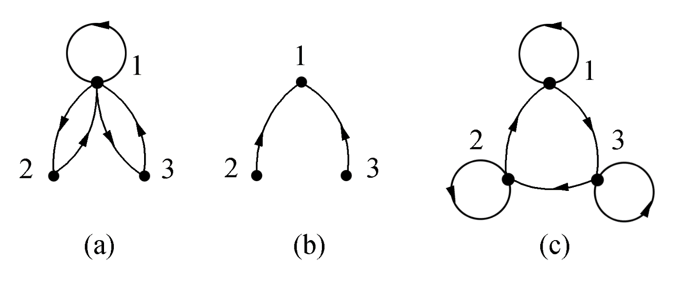
4.3.1 Definition and Determination of Relation Properties
⤷ Determine the Relation Based on the Relation Diagram (e.g.)
Example 8: Determine the properties of the relationship in the figure
below and explain the reasoning.
(a) Neither reflexive nor antireflexive; symmetric, not antisymmetric; not transitive.
(b) Antireflexive, not reflexive; antisymmetric, not symmetric; transitive.
(c) Reflexive, not antireflexive; antisymmetric, not symmetric; not transitive.
Notes:
教材p87，例4.9
(a)不自反也不反自反；对称, 不反对称；不传递.
(b)反自反，不是自反的；反对称，不是对称的；
是传递的.
(c)自反，不反自反；反对称，不是对称；不传递.

Slide 57

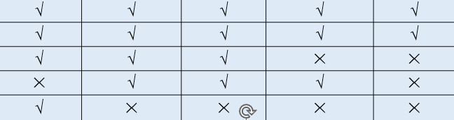

4.3.1 Definition and Determination of Relation Properties
⤷ Relation Between Operations and Properties
 | Reflexivity | Irreflexivity | Symmetry | Antisymmetry | Transitivity
R₁⁻¹ | √ | √ | √ | √ | √
R₁∩R₂ | √ | √ | √ | √ | √
R₁∪R₂ | √ | √ | √ | × | ×
R₁−R₂ | × | √ | √ | √ | ×
R₁∘R₂ | √ | × | × | × | ×
Notes:
差集 R−S 定义为包含所有那些在 R 中但不在 S 中的元素对的集合。

Slide 58
4.3 Properties of Relations
4.3.1 Definition and Determination of Relation Properties
Reflexivity and Irreflexivity
Symmetry and Antisymmetry
Transitivity
4.3.2 Closure of Relations
Definition of Closure
Closure Calculation
Warshall's Algorithm
Notes:
4.3.1关系性质的定义和判别
自反性与反自反性
对称性与反对称性
传递性
4.3.2 关系的闭包
闭包定义
闭包计算
Warshall算法

Slide 59
4.3.2 Closure of Relations
⤷ Definition of r(R), s(R) and t(R)
Definition 4.17: r(R), s(R) and t(R)
Let R be a relation on a non-empty set A. The reflexive (symmetric or transitive) closure of R is a relation R′ on A, such that R′ satisfies the following conditions:
R′ is reflexive (symmetric or transitive).
R⊆R′
For any reflexive (symmetric or transitive) relation R′′ on A that contains R, we have R′ ⊆ R′′ .
The reflexive closure of R is usually denoted by r(R), the symmetric closure by s(R), and the transitive closure by t(R).
Notes:
定义4.17 设R是非空集合A上的关系, R 的自反 (对称或传
递) 闭包 是A上的关系R′, 使得 R′满足以下条件：
(1) R′是自反的（对称的或传递的）
(2) R ⊆R′
(3) 对A上任何包含R 的自反（对称或传递）关系R′′ 有
R′⊆R′′.
一般将 R 的自反闭包记作 r(R), 对称闭包记作 s(R), 传递
闭包记作 t(R).

Slide 60
4.3.2 Closure of Relations
⤷ Construction of the Transitive Closure of Relation R
For a relation R on a non-empty set A, the reflexive closure r(R), symmetric closure s(R), and transitive closure t(R) can be constructed.
The reflexive closure R′ of R is a relation obtained by adding all necessary pairs to ensure reflexivity, and it is the smallest superset. It can be defined as: R′=R∪{(a,a)∣a∈A}
The symmetric closure R′ of R is a relation obtained by adding all necessary pairs to ensure symmetry, and it is the smallest superset. It can be defined as: R′=R∪{(b,a)∣(a,b)∈R}
Notes:
对非空集合A上关系 R 可构造自反闭包 r(R), 对称闭包 s(R), 传递闭包 t(R).
R的自反闭包R′是在R中添加了所有必要的元素对以确保自反性的关系， 是一个最小超集。可以定义为： R′=R∪{(a,a)∣a∈A}
R的对称闭包R′是在R中添加了所有必要的元素对确保对称性的关系， 是一个最小超集。可以定义为： R′=R∪{(b,a)∣(a,b)∈R}
R的传递闭包R′是在R中添加了所有必要的元素对确保传递性的关系，是一个最小超集。可以定义为：
对于 A 中的每一对元素 a,c，如果存在一个或多个元素 b₁​,b₂​,…,b_{n}​ 使得 (a,b₁​),(b₁​,b₂​),…,(b_{n−1}​,b_{n}​),(b_{n}​,c) 都在 R 中，那么 (a,c) 应该在R′ 中

Slide 61
4.3.2 Closure of Relations
⤷ Construction of the Transitive Closure of Relation R
The transitive closure R′ of R is a relation obtained by adding all necessary pairs to ensure transitivity, and it is the smallest superset. It can be defined as:
For each pair of elements a,c∈A, if there exist one or more elements b₁​,b₂​,…,b_{n}​ such that (a,b₁​),(b₁​,b₂​),…,(b_{n−1}​,b_{n}​),(b_{n}​,c) are all in R , then (a,c) should be in R′.
Notes:
对非空集合A上关系 R 可构造自反闭包 r(R), 对称闭包 s(R), 传递闭包 t(R).
R的自反闭包R′是在R中添加了所有必要的元素对以确保自反性的关系， 是一个最小超集。可以定义为： R′=R∪{(a,a)∣a∈A}
R的对称闭包R′是在R中添加了所有必要的元素对确保对称性的关系， 是一个最小超集。可以定义为： R′=R∪{(b,a)∣(a,b)∈R}
R的传递闭包R′是在R中添加了所有必要的元素对确保传递性的关系，是一个最小超集。可以定义为：
对于 A 中的每一对元素 a,c，如果存在一个或多个元素 b₁​,b₂​,…,b_{n}​ 使得 (a,b₁​),(b₁​,b₂​),…,(b_{n−1}​,b_{n}​),(b_{n}​,c) 都在 R 中，那么 (a,c) 应该在R′ 中

Slide 62
4.3.2 Closure of Relations
⤷ Closure Theorem of Relations
Theorem 4.7: Closure Theorem of Relations. Let R be a relation on A, then we have: (1) r(R)=R∪R⁰
(2) s(R)=R∪R⁻¹
(3) t(R)=R∪R²∪R³∪…
Explanation:
For a finite set A (where |A|=n) , the union in (3) will have at most R^{n}.
If R is reflexive, then r(R)=R; If R is symmetric, then s(R)=R; If R is transitive, then t(R)=R.
Notes:
虽然集合运算本身不是构造关系闭包的直接方法，但它们是在执行这些方法时必不可少的基础操作。
定理4.7 设R为A上的关系, 则有 (1) r(R)=R∪R⁰ (2) s(R)=R∪R⁻¹ (3) t(R)=R∪R²∪R³∪…
说明：
对于有穷集合A (|A|=n) 上的关系, (3)中的并最多不超过R^{n}. ? why
若R 是自反的，则 r(R)=R; 若 R 是对称的，则 s(R)=R;若
R 是传递的，则 t(R)=R.

Slide 63
4.3.2 Closure of Relations
⤷ Proof of Closure Theorem
Proof of Theorem 4.7 (Proving (1)).
Proof of (1) r(R)=R∪R^{0 ，}It is sufficient to show that R∪R⁰ satisfies the closure definition.
Proof that R∪R⁰ is a reflexive relation
Since R∪R⁰contains R ，and by I_{A}⊆R∪R⁰, we can conclude that R∪R⁰ is reflexive on A.
Proof that R∪R⁰ is the smallest reflexive relation containing R .
We need to show that no reflexive relation smaller than R∪R⁰ exists that contains R.
Assume R′ is a reflexive relation that contains R and and is smaller than R∪R⁰ I_{A}⊆R′, R⊆R′，Therefore, we have R∪R⁰=I_{A}∪R ⊆R′ ，which contradicts the assumption that R′ is smaller than R∪R^{0 .}
Notes:
定理4.7的证明（只证 (1) 和 (3) ）
证 (1) r(R)=R∪R^{0 ，}只需证明R∪R⁰ 满足闭包定义.
证R∪R⁰ 是自反关系
R∪R⁰包含了R ，由I_{A}⊆R∪R⁰可知 R∪R⁰ 在 A上是自反的.
证R∪R⁰是包含R 的最小的自反关系
需证明不存在比 R∪R⁰ 更小的自反关系，该关系同时包含 R
假设R′是包含R 、比 R∪R⁰ 更小的自反关系 ，那么I_{A}⊆R′, R⊆R′，因此有 R∪R⁰=I_{A}∪R ⊆R′ ，这与 R′ 比 R∪R⁰ 小的假设矛盾。

Slide 64
4.3.2 Closure of Relations
⤷ Proof of Closure Theorem(cont.)
Proof of (3) t(R)=R∪R²∪R³∪…
Consider arbitrary pairs <x,y> and <y,z>
<x,y>∈R∪R²∪R³∪…. ∧ <y,z>∈R∪R²∪R³∪….
⇒ <x,z>∈R∪R²∪R³∪….
Therefore, by the transitivity of R∪R²∪R³∪…. We have
t(R) ⊆R∪R²∪R³∪…
Next, we prove by induction that R^{n} ⊆t(R).
For n=1, the statement is obviously true. Assume it holds for n=k. For any <x,y>, we have
<x,y>∈R^{k+1}⇒ <x,y>∈R^{k}∘R ⇒∃t (<x,t>∈R^{k} ∧<t,y>∈R)
⇒∃t (<x,t>∈t(R)∧<t,y>∈t(R)) ⇒<x,y>∈t(R) （t(R) transitive）
Thus，R∪R²∪R³∪… ⊆ t(R)
Notes:
证(3) t(R)=R∪R²∪R³∪… 任取<x,y>和<y,z>
<x,y>∈R∪R²∪R³∪…. ∧ <y,z>∈R∪R²∪R³∪….
⇒ <x,z>∈R∪R²∪R³∪….
于是，由R∪R²∪R³∪….的传递性得
t(R) ⊆R∪R²∪R³∪…
对n 进行归纳证明 R^{n} ⊆t(R).
n=1时显然为真. 假设n=k时为真，那么对于任意<x,y>
<x,y>∈R^{k+1}⇒ <x,y>∈R^{k}∘R ⇒∃t (<x,t>∈R^{k} ∧<t,y>∈R)
⇒∃t (<x,t>∈t(R)∧<t,y>∈t(R)) ⇒<x,y>∈t(R) （t(R)传递）
于是， R∪R²∪R³∪… ⊆ t(R)
任意R 属于RN

Slide 65
4.3.2 Closure of Relations
⤷ Closure Matrix Representation
Let the relation matrices of R, r(R), s(R), t(R) be M, M_{r}, M_{s}
and M_{t} , respectively. Then, we have:
M_{r} =M+E
M_{s} =M+M’
M_{t} =M+M²+M³+…
where E is the identity matrix of the same order as M, and M’ is the transpose of M.
Note: In the above equations, the matrix elements are added using logical addition.
Notes:
设关系R, r(R), s(R), t(R)的关系矩阵分别为M, M_{r}, M_{s}
和 M_{t} , 则 M_{r} =M+E
M_{s} =M+M’
M_{t} =M+M²+M³+…
其中E 是和 M 同阶的单位矩阵, M’是 M 的转置矩阵.
注意：在上述等式中矩阵的元素相加时使用逻辑加.

Slide 66
4.3.2 Closure of Relations
⤷ Closure Operations on Relation Graphs
Let the relation graphs of R, r(R), s(R), t(R) be denoted by G, G_{r}, G_{s}, G_{t} , respectively.
Then, the vertex sets of G_{r}, G_{s}, G_{t} are the same as the vertex set of G.
In addition to the edges of G , new edges are added in the following ways：
For each vertex in G, if there is no cycle, add a cycle. The resulting graph is G_{r}.
For each directed edge x_{i} → x_{j}, (with i≠j), add a reverse edge x_{i} → x_{i} . The resulting graph is G_{s}.
For each vertex x_{i} in G, examine all paths starting from x_{i} ，if there is no edge from x_{i} to any node x_{j} in the path, add the corresponding edge. After checking all vertices, the resulting graph is G_{t} .
Notes:
无论是计算传递闭包、自反闭包、对称闭包还是其他类型的闭包，操作过程中保持节点集不变是常见的做法。这样做的主要原因是保持闭包操作的概念清晰和数学上的严谨性。在特殊情况下，如果需要改变节点集（例如，添加虚拟节点以简化某些计算），这通常会在特定上下文中明确指出。
设关系R, r(R), s(R), t(R)的关系图分别记为G, G_{r}, G_{s}, G_{t} , 则G_{r}, G_{s}, G_{t} 的顶点集与G 的顶点集相等.
除了G 的边以外, 以下述方法添加新的边：
考察G 的每个顶点, 如果没有环就加上一个环. 最终得到的是G_{r}.
考察G 的每一条边, 如果有一条 x_{i} 到 x_{i}的单向边, i≠j, 则在G中加一条 x_{i}到 x_{i} 的反方向边. 最终得到G_{s}.
考察G 的每个顶点 x_{i}, 找从 x_{i} 出发的每一条路径，如果从 x_{i} 到路径中的任何结点 x_{j} 没有边，就加上这条边. 当检查完所有的顶点后就得到图G_{t}

Slide 67
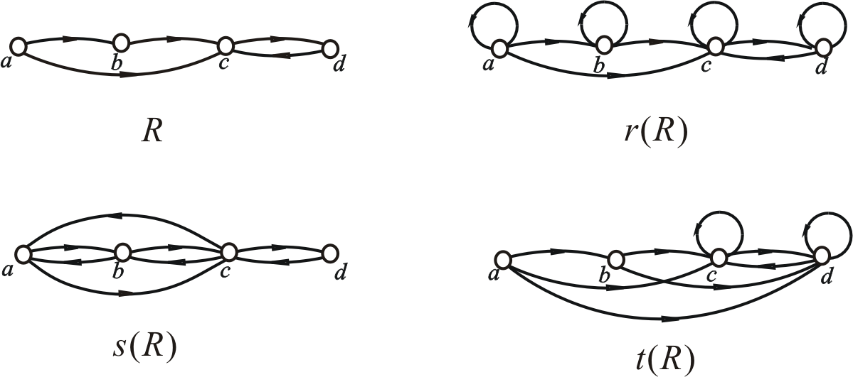
4.3.2 Closure of Relations
⤷ Closure Operations on Relation Graphs (e.g.)
Example: Let A={a,b,c,d}, R={<a,b>,<a,c>,<b,c>,<c,d>,<d,c>},
R and r(R), s(R), t(R) the relation graph is shown.
Notes:
Example 1 设A={a,b,c,d}, R={<a,b>,<a,c>,<b,c>,<c,d>,<d,c>},
R和 r(R), s(R), t(R)的关系图如下图所示.

Slide 68
4.3.2 Closure of Relations
⤷ Warshall's Algorithm for Transitive Closure
Algorithm Idea: Consider a sequence of matrices M₀, M₁, …, M_{n} of size n+1, where the element in the i-th row and j-th column of matrix M_{k} is denoted as M_{k}[i,j]. For k=0,1,…,n, M_{k}[i,j]=1 if and only if there exists a path from x_{i} to x_{j} in the relation graph of R , and this path passes through only the vertices in {x₁, x₂, …, x_{k}} except for the endpoints. It is easy to prove that M₀ is the relation matrix of R , and M_{n}​ corresponds to the transitive closure of R .
Warshall Algorithm: Starting from M₀​, calculate M₁, M₂, …, until M_{n} ​.
From M_{k} [i, j] to compute M_{k+1}[i, j]: i, j∈V.
The vertex set V₁={1,2, …, k}, V₂={k+2, …, n},V=V₁∪{k+1}∪V_{2，}
M_{k+1}[i,j]=1⇔ There exists a path i to j .
that only passes through the points in V₁∪{k+1}.
Notes:
Dynamic Programming
算法思路：
考虑 n+1个矩阵的序列M₀, M₁, …, M_{n}, 将矩阵 M_{k} 的 i 行 j
列的元素记作M_{k}[i,j]. 对于k=0,1,…,n, M_{k}[i,j]=1当且仅当在
R 的关系图中存在一条从 x_{i} 到 x_{j} 的路径，并且这条路径
除端点外中间只经过{x₁, x₂, …, x_{k}}中的顶点. 不难证明M₀
就是R 的关系矩阵，而 M_{n} 就对应了R 的传递闭包.
Warshall算法：
从M₀开始，顺序计算 M₁, M₂, …, 直到 M_{n} 为止.

Slide 69
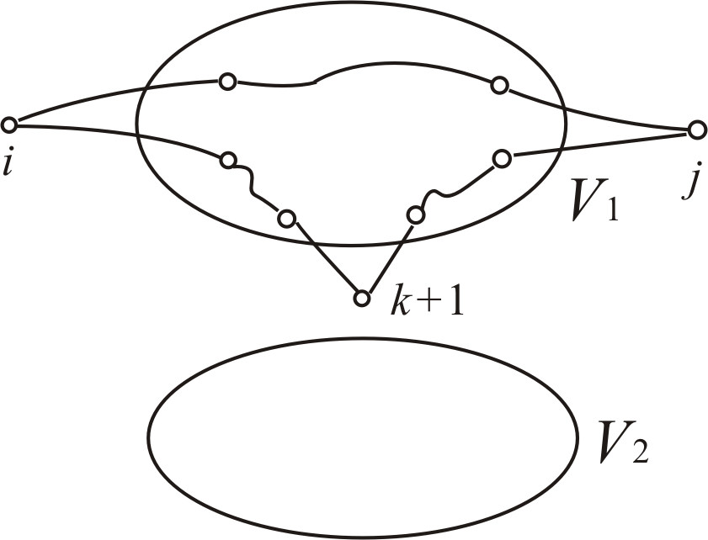
4.3.2 Closure of Relations
⤷ Warshall's Algorithm for Transitive Closure (cont.)
These paths are divided into two categories:
Category 1: Paths that only pass through the points inV₁
Category 2: Paths that pass through point k+1
For Category 1 paths：M_{k}[i,j]=1
For Category 2 paths:
M_{k}[i,k+1]=1 ∧ M_{k}[k+1,j]=1
Notes:
从 M_{k} [i, j] 计算 M_{k+1}[i, j]: i, j∈V.
顶点集 V₁={1,2, …, k}, V₂={k+2, …, n},V=V₁∪{k+1}∪V_{2，}
M_{k+1}[i,j]=1⇔ 存在从i 到 j 中间只经过V₁∪{k+1}中点的路径
这些路径分为两类：
第1类：只经过 V₁中点
第2类：经过 k+1点
存在第1类路径：M_{k}[i,j]=1
存在第2类路径：
M_{k}[i,k+1]=1∧M_{k}[k+1,j]=1

Slide 70
4.3.2 Closure of Relations
⤷ Warshall's Algorithm for Transitive Closure (cont.)
Algorithm 4.1: Warshall Algorithm
Input：M （relation matrix of R ）
Output：M_{t} （relation matrix of t(R)）
1. M_{t}←M
2. for k←1 to n do
3. for i←1 to n do
4. for j←1 to n do
M_{t}[i, j] ←M_{t}[i, j] or M_{t}[i, k]⋅M_{t}[k, j]
Time Complexity: T(n)=O(n³)
Notes:
算法4.1 Warshall算法
输入：M （R 的关系矩阵）
输出：M_{t} （t(R)的关系矩阵）
1. M_{t}←M
2. for k←1 to n do
3. for i←1 to n do
4. for j←1 to n do
M_{t}[i, j] ←M_{t}[i, j] + M_{t}[i, k]⋅M_{t}[k, j]
时间复杂度 T(n)=O(n³)

Slide 71
4.3 Properties of Relations• Brief summary
Objective :
Key Concepts ：

Slide 72
Discrete Mathematics 2025 Spring
魏可佶 kejiwei@tongji.edu.cn

Slide 73
Chapter 4：Relations
4.1 Definition and Representation of Relations
4.2 Operations on Relations
4.3 Properties of Relations
4.4 Equivalence Relations and Partial Order Relations
Notes:
4.1 关系的定义及其表示
4.2 关系运算
4.3 关系的性质
4.4 等价关系与偏序关系

Slide 74
4.4 Equivalence Relations and Partial Order Relations
4.4.1 Equivalence Relations
4.4.2 Equivalence Classes and Quotient Sets
4.4.3 Partition of a Set
4.4.4 Partial Order Relations
4.4.5 Partially Ordered Sets and Hasse Diagrams
Notes:
4.4.1 等价关系
4.4.2 等价类和商集
4.4.3 集合的划分
4.4.4 偏序关系
4.4.5 偏序集与哈斯图

Slide 75
4.4.1 Equivalence Relations
⤷ Equivalence relation ～
Definition 4.18: let R be a relation on a non-empty set. If R is reflexive, symmetric, and transitive, then R is called an equivalence relation on A. If R is an equivalence relation and <x,y>∈R, we say that x is equivalent to y, denoted as x～y.
Example: Verify that R is an equivalence relation on A.
Let A={1, 2, …, 8} , and define the relation R on A as follows ： R={<x,y>| x,y∈A∧x≡y (mod 3)}
where x≡y (mod 3) means that x and y are congruent modulo 3, i.e., the remainder when x is divided by 3 is equal to the remainder when y is divided by 3.
Notes:
1,4,7 2,5,8 3,6
定义4.18 设R为非空集合上的关系. 如果R是自反的、对称的和传递的, 则称R为A上的等价关系. 设 R 是一个等价关系, 若<x,y>∈R, 称 x等价于y, 记做x～y.
例1 设 A={1, 2, …, 8}, 如下定义 A上的关系R： R={<x,y>| x,y∈A∧x≡y (mod 3)} 其中 x≡y (mod 3) 叫做 x与y 模3相等, 即 x 除以3的余数与 y 除以3的余数相等.
不难验证R为A上的等价关系, 因为 ∀x∈A, 有x≡x(mod 3) （自反性） ∀x,y∈A, 若x≡y(mod 3), 则有y≡x(mod 3) （对称性） ∀x,y,z∈A, 若x≡y(mod 3), y≡z(mod 3), 则有
x≡z(mod 3) （传递性）

Slide 76
4.4.1 Equivalence Relations
⤷ Equivalence relation ～(e.g.)
Example: Let A={1, 2, …, 8} , and define the relation R on A as follows ： R={<x,y>| x,y∈A∧x≡y (mod 3)} where x≡y (mod 3) means that x and y are congruent modulo 3, i.e., the remainder when x is divided by 3 is equal to the remainder when y is divided by 3.
It is easy to verify that R is an equivalence relation on A, because:
∀x∈A, if x≡x(mod 3) （reflexivity）
∀x,y∈A, if x≡y(mod 3), then y≡x(mod 3) （symmetry）
∀x,y,z∈A, if x≡y(mod 3), y≡z(mod 3), then
x≡z(mod 3) （transitivity）
Notes:
1,4,7 2,5,8 3,6
定义4.18 设R为非空集合上的关系. 如果R是自反的、对称的和传递的, 则称R为A上的等价关系. 设 R 是一个等价关系, 若<x,y>∈R, 称 x等价于y, 记做x～y.
例1 设 A={1, 2, …, 8}, 如下定义 A上的关系R： R={<x,y>| x,y∈A∧x≡y (mod 3)} 其中 x≡y (mod 3) 叫做 x与y 模3相等, 即 x 除以3的余数与 y 除以3的余数相等.
不难验证R为A上的等价关系, 因为 ∀x∈A, 有x≡x(mod 3) （自反性） ∀x,y∈A, 若x≡y(mod 3), 则有y≡x(mod 3) （对称性） ∀x,y,z∈A, 若x≡y(mod 3), y≡z(mod 3), 则有
x≡z(mod 3) （传递性）

Slide 77
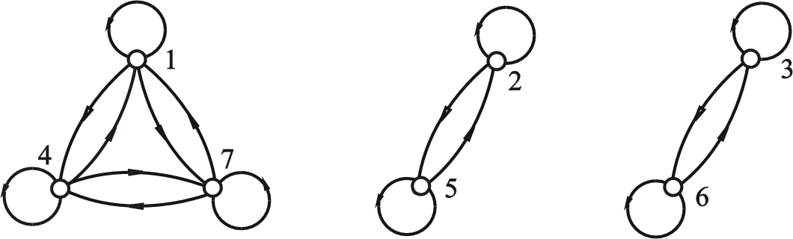
4.4.1 Equivalence Relations
⤷ Equivalence relation graph (e.g.)
Relation Graph of the Modulo 3 Equivalence Relation on A
Let A={1, 2, …, 7}, R={ <x,y>| x,y∈A∧x≡y (mod 3) }
The relation graph of R is shown below ：
Notes:
A上模3等价关系的关系图
设 A={1, 2, …, 7}, R={ <x,y>| x,y∈A∧x≡y (mod 3) }
R 的关系图如下

Slide 78
4.4 Equivalence Relations and Partial Order Relations
4.4.1 Equivalence Relations
4.4.2 Equivalence Classes and Quotient Sets
4.4.3 Partition of a Set
4.4.4 Partial Order Relations
4.4.5 Partially Ordered Sets and Hasse Diagrams
Notes:
4.4.1 等价关系
4.4.2 等价类和商集
4.4.3 集合的划分
4.4.4 偏序关系
4.4.5 偏序集与哈斯图

Slide 79
4.4.2 Equivalence Classes and Quotient Sets
⤷ Equivalence Classes
Definition 4.19: let R be an equivalence relation on a non-empty set A, ∀x∈A，define [x]_{R} = { y| y∈A ∧ xRy }
We call [x]_{R} the equivalence class of x under R, or simply the equivalence class of x, denoted as [x].
Note: [x]_{R} is the set of all elements in A that are equivalent to x under the relation R.
[x]_{R} ={y∈A∣(x,y)∈R}
Notes:
等价类是集合 A 中所有与 x 相关（即在关系 R 下等价）的元素的集合。如<x,y>∈R, 可记作 xRy；
[x]={y∈A∣(x,y)∈R}
这里，[x] 是集合 A 中所有与 x 在关系 R 下等价的元素的集合。
余数为 0 的等价类：包括所有除以 3 余数为 0 的数。在集合 A 中，这些数是 {3,6}{3,6}。
余数为 1 的等价类：包括所有除以 3 余数为 1 的数。在集合 A 中，这些数是 {1,4,7}{1,4,7}。
余数为 2 的等价类：包括所有除以 3 余数为 2 的数。在集合 A 中，这些数是 {2,5,8}{2,5,8}。
定义4.19 设R为非空集合A上的等价关系, ∀x∈A，令 [x]_{R} = { y | y∈A∧xRy }
称 [x]_{R} 为x关于R 的等价类, 简称为 x 的等价类, 简记为[x].
注： [x]_{R}是集合 A 中所有与 x 在关系 R 下等价的元素的集合。
[x]_{R} ={y∈A∣(x,y)∈R} 实例 A={ 1, 2, … , 8 }上模 3 等价关系的等价类： [1]=[4]=[7]={1,4,7} [2]=[5]=[8]={2,5,8} [3]=[6]={3,6}
以上余数分别为1,2,0的三个等价类互不相交，并集为A

Slide 80
4.4.2 Equivalence Classes and Quotient Sets
⤷ Equivalence Classes (e.g.)
Example: Equivalence classes of the modulo 3 equivalence relation on A={1, 2, … , 8} ： [1]=[4]=[7]={1,4,7} [2]=[5]=[8]={2,5,8} [3]=[6]={3,6}
The three equivalence classes with remainders 1, 2, and 0 are disjoint, and their union is A.
Notes:
等价类是集合 A 中所有与 x 相关（即在关系 R 下等价）的元素的集合。如<x,y>∈R, 可记作 xRy；
[x]={y∈A∣(x,y)∈R}
这里，[x] 是集合 A 中所有与 x 在关系 R 下等价的元素的集合。
余数为 0 的等价类：包括所有除以 3 余数为 0 的数。在集合 A 中，这些数是 {3,6}{3,6}。
余数为 1 的等价类：包括所有除以 3 余数为 1 的数。在集合 A 中，这些数是 {1,4,7}{1,4,7}。
余数为 2 的等价类：包括所有除以 3 余数为 2 的数。在集合 A 中，这些数是 {2,5,8}{2,5,8}。
定义4.19 设R为非空集合A上的等价关系, ∀x∈A，令 [x]_{R} = { y | y∈A∧xRy }
称 [x]_{R} 为x关于R 的等价类, 简称为 x 的等价类, 简记为[x].
注： [x]_{R}是集合 A 中所有与 x 在关系 R 下等价的元素的集合。
[x]_{R} ={y∈A∣(x,y)∈R} 实例 A={ 1, 2, … , 8 }上模 3 等价关系的等价类： [1]=[4]=[7]={1,4,7} [2]=[5]=[8]={2,5,8} [3]=[6]={3,6}
以上余数分别为1,2,0的三个等价类互不相交，并集为A

Slide 81
4.4.2 Equivalence Classes and Quotient Sets
⤷ Partition Theorem of Equivalence Classes
Theorem 4.8: Partition Theorem of Equivalence Classes.
Let R be an equivalence relation on a non-empty set A
The following conclusions hold:
(1) ∀x∈A, [x] is a non-empty subset of A.
(2) ∀x, y∈A, if xRy, then [x]=[y].
(3) ∀x, y∈A, if x y, then [x] and [y] are disjoint.
(4) , the union of all equivalence classes is equal to A.
Notes:
定理4.8 设R是非空集合A上的等价关系, 如下结论成立 (1) ∀x∈A, [x] 是A的非空子集. (2) ∀x, y∈A, 如果 xRy, 则 [x]=[y]. (3) ∀x, y∈A, 如果 x y, 则 [x]与[y]不交. (4) ，即所有等价类的并集就是A.

Slide 82
4.4.2 Equivalence Classes and Quotient Sets
⤷ Proof of the Partition Theorem of Equivalence Classes
Theorem 4.8(1): ∀x∈A, [x] is a non-empty subset of A.
Proof: From the definition of equivalence classes, ∀x∈A, we have [x]⊆A. By reflexivity, xRx，so x∈[x], which implies that [x] is non-empty. Since all elements in the equivalence class [x] are selected from the set A， it follows that [x] is a subset of A.
Theorem 4.8(2): ∀x, y∈A, if xRy, then [x]=[y].
Proof: For any element a in [x]，(x,a)∈R. Since (x,y)∈R and R is transitive, we can conclude that (y,a)∈R , so a ∈[y]. This proves that [x]⊆[y].
Similarly, we can prove that [y] ⊆ [x]. Therefore [x]=[y] .
Notes:
定理4.8(1)： ∀x∈A, [x] 是A的非空子集
由等价类定义可知, ∀x∈A有[x]⊆A. 由自反性有xRx，因此必有x∈[x], 即[x]非空.
由于等价类[x]中的所有元素都是从集合A中选取的，因此[x]是集合A 的一个子集。
定理4.8(2)： ∀x, y∈A, 如果 xRy, 则 [x]=[y].
对于[x]中的任意元素a，有(x,a)∈R。 (x,y)∈R 并且R是传递的，可以得出 (y,a)∈R ，即a也属于[y] 。这证明了 [x]⊆[y]。
同理可证[y] ⊆ [x]. 这就得到了[x]=[y] .

Slide 83

4.4.2 Equivalence Classes and Quotient Sets
⤷ Proof of the Partition Theorem of Equivalence Classes (cont.)
Theorem 4.8(3): ∀x, y∈A, if x y, then [x] and [y] are disjoint.
Proof:
Suppose [x]∩[y]≠∅, then there exists an element z∈[x]∩[y], which implies z∈[x]∧z∈[y], then <x,z>∈R∧<y,z>∈R holds.
By the transitivity and symmetry of R, then <x,y>∈R, contradicted to x y.
Notes:
定理4.8(3)：∀x, y∈A, 如果 x y, 则 [x]与[y]不交. 假设[x]∩[y]≠∅, 则存在z∈[x]∩[y], 从而有
z∈[x]∧z∈[y], 即<x,z>∈R∧<y,z>∈R 成立.
根据R 的对称性和传递性必有<x,y>∈R, 与x y矛盾

Slide 84
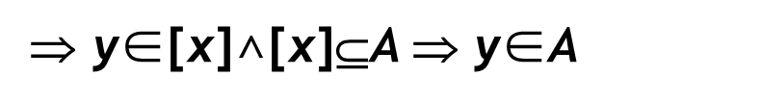
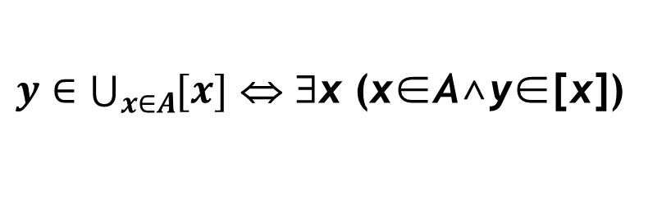
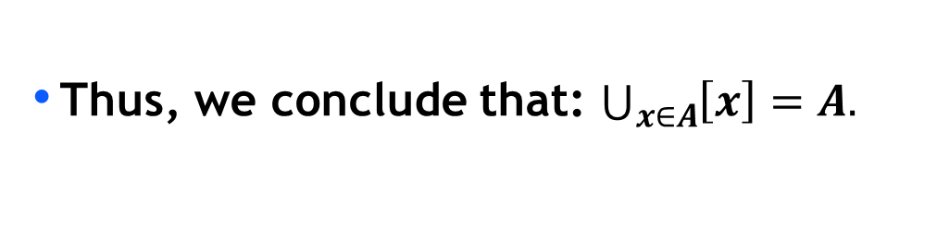

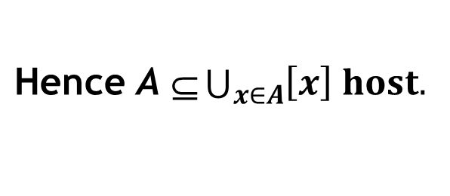

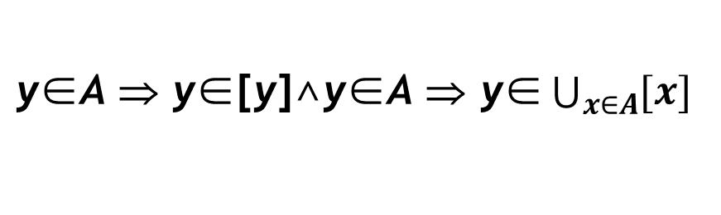
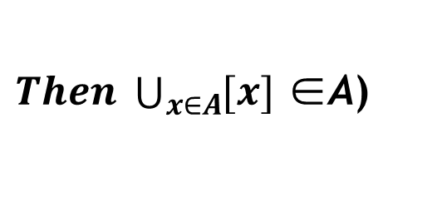
4.4.2 Equivalence Classes and Quotient Sets
⤷ Proof of the Partition Theorem of Equivalence Classes (cont.)
Theorem 4.8(4):
, the union of all equivalence classes is A.
Proof1: $\bigcup_{x∈A}{\left[x\right]∈A ,\text{For} \text{any} \text{y}\text{.}}$
Proof2: $A∈\bigcup_{x∈A}{\left[x\right] ,\text{For} \text{any} \text{y}\text{.}}$
$$\bigcup_{x∈A}{\left[x\right]=A}$$
$y∈\bigcup_{x∈A}{[x]}$ ⇔ ∃x (x∈A∧y∈[x])
⇒ y∈[x]∧[x]⊆A ⇒ y∈A
$Then \bigcup_{x∈A}{[x]}$ ∈A)
$\text{y}\text{∈}\text{A} \text{⇒} \text{y}\text{∈[}\text{y}\text{]∧}\text{y}\text{∈}\text{A} \text{⇒} \text{y}\text{∈}\bigcup_{x∈A}{[x]}$
$\text{Hence} \text{A} \text{⊆}\bigcup_{x∈A}{\left[x\right] host.}$
Thus, we conclude that: $\bigcup_{x∈A}{\left[x\right]=A.}$
Notes:
定理4.8(4)： ，即所有等价类的并集就是A.
先证 . 任取y, 
y∈ ⇔ ∃x (x∈A∧y∈[x])
⇒ y∈[x]∧[x]⊆A ⇒ y∈A
从而有 .
再证A⊆ . 任取y,
y∈A ⇒ y∈[y]∧y∈A ⇒ y∈
从而有A⊆ 成立. 综上所述得 = A

Slide 85
4.4.2 Equivalence Classes and Quotient Sets
⤷ Quotient Sets
Definition 4.20: Let R be an equivalence relation on a non-empty set A. The set of equivalence classes of R is called the quotient set of A with respect to R, denoted by A/R,
A/R = { [x]_{R} | x∈A }
Example: Let A={1, 2, …, 8}，the quotient set of A with respect to the equivalence relation R modulo 3 is: A/R = { {1, 4,7}, {2, 5, 8}, {3, 6} }
The quotient sets of A with respect to the identity relation and the universal relation are:
A/I_{A} = { {1},{2}, … ,{8}}
A/E_{A} = { {1, 2, … ,8} }
Notes:
全域关系下的商集只包含一个元素，即原始集合 A 自身
定义4.20 设R 为非空集合A 上的等价关系, 以R 的所有等价类作为元素的集合称为A关于R 的商集, 记做 A/R,
A/R = { [x]_{R} | x∈A }
例2
令A={1, 2, …, 8}，A关于模 3 等价关系R 的商集为 A/R = { {1, 4,7}, {2, 5, 8}, {3, 6} }
A关于恒等关系和全域关系的商集为：
A/I_{A} = { {1},{2}, … ,{8}}
A/E_{A} = { {1, 2, … ,8} }

Slide 86
4.4 Equivalence Relations and Partial Order Relations
4.4.1 Equivalence Relations
4.4.2 Equivalence Classes and Quotient Sets
4.4.3 Partition of a Set
4.4.4 Partial Order Relations
4.4.5 Partially Ordered Sets and Hasse Diagrams
Notes:
4.4.1 等价关系
4.4.2 等价类和商集
4.4.3 集合的划分
4.4.4 偏序关系
4.4.5 偏序集与哈斯图

Slide 87
4.4.3 Partition of a Set
⤷ Quotient Sets
Definition 4.21: Let A be a non-empty set, A family of subset π (π ⊆P(A)), if it satisfies the following conditions：
(1) ∅∉π ; (2) ∀x∀y (x,y∈π∧x≠y→x∩y=∅); (3) ∪π =A
Then π is called a partition of A, and the element of π are called blocks of the partition of A.
Example: Let A＝{a, b, c, d}, given the partitions:
π ₁={{a, b, c},{d}}， π ₂={{a, b},{c},{d}} π ₃={{a},{a, b, c, d}}， π ₄={{a, b},{c}} π ₅={∅,{a, b},{c, d}}， π ₆={{a,{a}},{b, c, d}}
Then π _{1,} π ₂ are partitions of A , while the others are not.
Notes:
等价关系的划分块可以表示为等价类，划分提供了一种将复杂问题分解为更简单部分x的方法。 X和y是划分快
定义4.21 设A为非空集合, 若A的子集族π (π ⊆P(A)) 满足下面条件：
(1) ∅∉π
(2) ∀x∀y (x,y∈π∧x≠y→x∩y=∅) (3) ∪π =A 则称π是A的一个划分, 称π 中的元素为A的划分块. 例3 设A＝{a, b, c, d}, 给定π ₁, π ₂, π ₃, π ₄, π ₅, π ₆如下：
π ₁={{a, b, c},{d}}， π ₂={{a, b},{c},{d}} π ₃={{a},{a, b, c, d}}， π ₄={{a, b},{c}} π ₅={∅,{a, b},{c, d}}， π ₆={{a,{a}},{b, c, d}} 则π ₁和π ₂是A的划分, 其他都不是A的划分.

Slide 88
4.4.3 Partition of a Set
⤷ Correspondence Between Partitions and Equivalence Relations
The quotient set A/R is a partition of A .
Different quotient sets correspond to different partitions.
Given any partition π of A , we define a relation R on A as follows： R ={<x,y> | x,y∈A and [x]_{π}​=[y]_{π}​}
([x]_{π}​=[y]_{π} : x and y are in the same partition block of π )
Then, R is an equivalence relation on A, and the quotient set determined by this equivalence relation is exactly π.
Example: List all equivalence relations on A＝{1,2,3}
Solution approach:
First, determine all partitions of A, and then write out the corresponding equivalence relations based on these partitions.
Notes:
商集 A/R 就是A 的一个划分
不同的商集对应于不同的划分
任给A 的一个划分π , 如下定义A 上的关系 R： R ={<x,y> | x,y∈A∧x 与 y 在π的同一划分块中 } 则R 为A上的等价关系, 且该等价关系确定的商集就是π.
例4 给出A＝{1,2,3}上所有的等价关系
求解思路：先做出A的所有划分, 然后根据划分写出
对应的等价关系.

Slide 89
4.4.3 Partition of a Set
⤷ Set Partitions and Equivalence Relation(e.g.)
Determine all partitions of A＝{1,2,3}
2
2
2
2
2
1
3
1
3
1
3
1
3
1
3
π₁
π₂
π₃
π₄
π₅
π₁ corresponds to the universal relation E_{A}
π₅ corresponds to the identity relation I_{A}
π₂,π₃ π₃correspond to the equivalence relations R₂, R₃ 和 R₄.
R₂={<2,3>,<3,2>}∪I_{A}
R₃={<1,3>,<3,1>}∪I_{A}
R₄={<1,2>,<2,1>}∪I_{A}
Notes:
π₁对应于全域关系 E_{A}，π₅ 对应于恒等关系 I_{A}
π₂,π₃和π₃分别对应等价关系 R₂, R₃ 和 R₄.

Slide 90
4.4.3 Partition of a Set
⤷ Set Partitions and Equivalence Relation(e.g.)
Example: Let A={1,2,3,4}
Define a binary relation R on A×A：
<<x, y>,<u, v>>∈R ⇔ x+y = u+v, find the partition induced by R.
Solution: A×A={<1,1>, <1,2>, <1,3>, <1,4>, <2,1>, <2,2>, <2,3>, <2,4>,<3,1>, <3,2>, <3,3>, <3,4>, <4,1>, <4,2>,<4,3>, <4,4>}
According to the sum condition <x,y> and x+y=2,3,4,5,6,7,8 which partition A×A into 7 equivalence classes:
(A×A)/R={{<1,1>}, {<1,2>,<2,1>}, {<1,3>, <2,2>, <3,1>},
{<1,4>, <2,3>, <3,2>, <4,1>}, {<2,4>, <3,3>, <4,2>},
{<3,4>, <4,3>}, {<4,4>}}
Notes:
x+y=2,3,4,5,6,7,8

Slide 91
4.4 Equivalence Relations and Partial Order Relations
4.4.1 Equivalence Relations
4.4.2 Equivalence Classes and Quotient Sets
4.4.3 Partition of a Set
4.4.4 Partial Order Relations
4.4.5 Partially Ordered Sets and Hasse Diagrams
Notes:
4.4.1 等价关系
4.4.2 等价类和商集
4.4.3 集合的划分
4.4.4 偏序关系
4.4.5 偏序集与哈斯图

Slide 92
4.4.4 Partial Order Relations
⤷ Partial Order Relation on Set A
Definition 4.22: A relation on a non-empty set that is reflexive, antisymmetric, and transitive is called a partial order relation on A, denoted by ≼. If <x, y>∈≼, then we write it as x≼y, which is read as x “less than or equal” y.
Examples:
The identity relation I_{A} on set A is a partial order relation on A .
The less than or equal to relation, divisibility relation, and subset inclusion relation are also partial order relations on their respective sets.
Notes:
Why ≼不仅仅是小于等于关系
定义4.22 非空集合A上的自反、反对称和传递的关系，称为A上的偏序关系，记作≼. 设≼为偏序关系, 如果
<x, y>∈≼, 则记作 x≼y, 读作 x“小于或等于”y.
实例
集合A上的恒等关系 I_{A} 是A上的偏序关系.
小于或等于关系, 整除关系和包含关系也是相应集合上的偏序关系.

Slide 93
4.4.4 Partial Order Relations
⤷ Characteristics of Partial Order - Comparability and Total Order
Definition 4.23: Comparability
Let R be a partial order relation on a non-empty set A,
For x, y∈A, we say that x and y are comparable if and only if x⪯y or y⪯x.
Condition for incomparability: If no partial order relation relates x and y, then they are not comparable.
Definition 4.24: Total Order
If R is a partial order on a non-empty set A, ∀x, y∈A, x and y are always comparable, R is called a total order.
Notes:
3,9 5,7 每对元素都可比 称为全序 <不相等
定义4.23 x与y可比 设R为非空集合A上的偏序关系, x, y∈A, x与y 可比 ⇔ x≼y ∨ y≼x.
x, y 不可比的条件：不存在任何偏序关系将它们联系起来
定义4.25 全序 R为非空集合A上的偏序, ∀x, y∈A, x与y 都可比，则称R为全序.
定义4.26 覆盖 x,y∈A, 如果x≺y且不存在 z∈A使得 x≺z≺y, 则称 y覆盖x.
实例：数集(如实数集、整数集等)上的小于或等于关系是全序关系
整除关系不是正整数集合上的全序关系
{1, 2, 4, 6}集合上的整除关系, 2覆盖1, 4 和 6 覆盖2.
但4不覆盖1.

Slide 94
4.4.4 Partial Order Relations
⤷ Characteristics of Partial Order - Covering
Examples:
The "less than or equal to" relation on numerical sets (such as real numbers and integers) is a total order.’
The divisibility relation is not a total order on the set of positive integers.
Definition 4.25: Covering
x,y∈A, if x≺y and there is no z∈A such that x≺z≺y, then we say that y covers x.
Such as: On the set {1, 2, 4, 6} with the divisibility relation:
2 covers1, 4 and 6 covers2.
4 doesn’t cover 1.
Notes:
3,9 5,7 每对元素都可比 称为全序 <不相等
定义4.23 x与y可比 设R为非空集合A上的偏序关系, x, y∈A, x与y 可比 ⇔ x≼y ∨ y≼x.
x, y 不可比的条件：不存在任何偏序关系将它们联系起来
定义4.25 全序 R为非空集合A上的偏序, ∀x, y∈A, x与y 都可比，则称R为全序.
定义4.26 覆盖 x,y∈A, 如果x≺y且不存在 z∈A使得 x≺z≺y, 则称 y覆盖x.
实例：数集(如实数集、整数集等)上的小于或等于关系是全序关系
整除关系不是正整数集合上的全序关系
{1, 2, 4, 6}集合上的整除关系, 2覆盖1, 4 和 6 覆盖2.
但4不覆盖1.

Slide 95
4.4 Equivalence Relations and Partial Order Relations
4.4.1 Equivalence Relations
4.4.2 Equivalence Classes and Quotient Sets
4.4.3 Partition of a Set
4.4.4 Partial Order Relations
4.4.5 Partially Ordered Sets and Hasse Diagrams
Notes:
4.4.1 等价关系
4.4.2 等价类和商集
4.4.3 集合的划分
4.4.4 偏序关系
4.4.5 偏序集与哈斯图

Slide 96
4.4.5 Partially Ordered Sets and Hasse Diagrams
⤷ Partially Ordered Set
Definition 4.26： Partially ordered set. A partially ordered set (poset) consists of a set A together with a partial order relation ≼ , denoted as <A,≼>.
Such as：
The set of integers with the "less than or equal to" relation forms a poset <Z,≤>.
The power set P(A) with the subset inclusion relation forms a poset <P(A),R⊆>.
Notes:
哈斯图（Hasse diagram）的主要目的是为了提供一种清晰且简洁的方式来可视化偏序集的结构，特别是展示集合中元素之间的偏序关系。
幂集（英语：power set），定义为由该集合全部子集为元素构成的集合。
1.自反
2.移走所有传递性的边
定义4.27 集合A和A上的偏序关系≼一起叫做偏序集, 记作<A,≼>. 实例：整数集和数的小于等于关系构成偏序集<Z,≤>
幂集P(A)和包含关系构成偏序集<P(A),R⊆>.
哈斯图：利用偏序自反、反对称、传递性简化的关系图
特点：
每个结点没有环
两个连通的结点之间的序关系通过结点位置的高低
表示，位置低的元素的顺序在前
具有覆盖关系的两个结点之间连边

Slide 97
4.4.5 Partially Ordered Sets and Hasse Diagrams
⤷ Simplified representation of a poset - Hasse diagram
Hesse Diagram: A simplified graphical representation of a partial order that eliminates reflexivity, antisymmetry, and transitivity in the diagram.
Characteristics:
Each node has no self-loops.
The order between two connected nodes is represented by their relative position: Lower-positioned elements come earlier in the order.
There is an edge between two nodes if and only if they have a covering relation.
A Hasse diagram is a special type of relational graph for posets, with transitive edges removed and implicit direction.
Notes:
哈斯图（Hasse diagram）的主要目的是为了提供一种清晰且简洁的方式来可视化偏序集的结构，特别是展示集合中元素之间的偏序关系。
幂集（英语：power set），定义为由该集合全部子集为元素构成的集合。
1.自反
2.移走所有传递性的边
定义4.27 集合A和A上的偏序关系≼一起叫做偏序集, 记作<A,≼>. 实例：整数集和数的小于等于关系构成偏序集<Z,≤>
幂集P(A)和包含关系构成偏序集<P(A),R⊆>.
哈斯图：利用偏序自反、反对称、传递性简化的关系图
特点：
每个结点没有环
两个连通的结点之间的序关系通过结点位置的高低
表示，位置低的元素的顺序在前
具有覆盖关系的两个结点之间连边

Slide 98
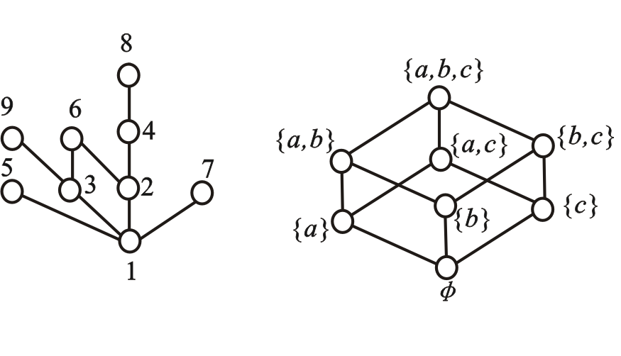
4.4.5 Partially Ordered Sets and Hasse Diagrams
⤷ Simplified representation of a poset - Hasse diagram(e.g.)
Example : <{ 1, 2, 3, 4, 5, 6, 7, 8, 9 }, R_{Div}>
<P({a, b, c}), R⊆>

Slide 99
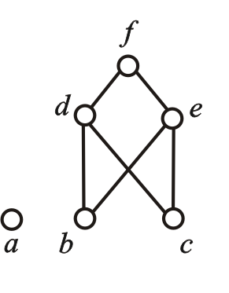
4.4.5 Partially Ordered Sets and Hasse Diagrams
⤷ Simplified representation of a poset - Hasse diagram(e.g.)
Example : Given the Hasse diagram of the partially ordered set <A,R> shown below, find the expression for the set A and the relation R.
Solution: ①Identify the Elements in A;②Extract the Covering Relations;③Complete transitive and reflexive relations.
A={a, b, c, d, e, f} R={<b,d>,<b,e>,<b,f>,<c,d>,<c,e>,<c,f>,<d,f>,<e,f>}∪I_{A}
Notes:
例7
已知偏序集<A,R>
的哈斯图如下图所示,
试求出集合A和关系
R的表达式.

Slide 100
4.4.5 Partially Ordered Sets and Hasse Diagrams
⤷ Key elements of a poset and their properties
Definition 4.27: Let <A,≼> be a partially ordered set (poset), B⊆A, y∈B.
(1) if ∀x(x∈B→y≼x), then y is called the least element of B.
(2) if ∀x(x∈B→x≼y), then y is called the greatest element of B.
(3) If ∀x(x∈B∧x≼y→x=y), then y is called a minimal element of B.
(4) If ∀x(x∈B∧y≼x→x=y), then y is called a maximal element of B.
Properties:
In a finite set, minimal and maximal elements always exist and may not be unique.
Least and greatest elements are not guaranteed to exist, but if they do, they are unique.
The least element is always a minimal element.
The greatest element is always a maximal element.
Isolated nodes are both minimal and maximal elements.
Notes:
定义4.28 设<A,≼>为偏序集, B⊆A, y∈B. (1) 若∀x(x∈B→y≼x)成立, 则称 y 为 B 的最小元. (2) 若∀x(x∈B→x≼y)成立, 则称 y 为 B 的最大元. (3) 若∀x(x∈B∧x≼y→x=y)成立, 则称 y 为B的极小元. (4) 若∀x(x∈B∧y≼x→x=y)成立, 则称 y 为B的极大元.
性质：
对于有穷集，极小元和极大元必存在，可能存在多个.
最小元和最大元不一定存在，如果存在一定唯一.
最小元一定是极小元；最大元一定是极大元.
孤立结点既是极小元，也是极大元.

Slide 101
4.4.5 Partially Ordered Sets and Hasse Diagrams
⤷ Upper/lower bounds, supremum, infimum of a poset
Definition 4.28: Let<A, ≼> be a partially ordered set (poset), and let B⊆A, y∈A.
(1) If ∀x (x∈B→x≼y) , then y is called an upper bound of B.
(2) If ∀x (x∈B→y≼x) , then y is called a lower bound of B.
(3) Let C＝{y | y is an upper bound of B}, the least element of C, if it exists, is called the least upper bound (supremum) of B or the supremum.
(4) Let D＝{y | y is a lower bound of B}, The greatest element of D, if it exists, is called the greatest lower bound (infimum) of B or the infimum.
Notes:
, y∈A. 大小元y∈B所以，如果一个集合有最小元，那这个最小元就是它的下确界，因为没有比这个最小元还要小的元素能够成为下确界；同理，如果一个集合有最大元，那这个最大元就是它的上确界。但是，有些集合的上确界或下确界可能不存在于集合之内，这种情况下，上确界或下确界不是集合的元素。
举个例子，考虑实数集合[0,1)（包括0但不包括1的所有实数），它的下确界是0，因为0是集合中的最小元素。但它的上确界是1，尽管1不属于集合[0,1)。这个例子说明了，即使集合的上确界或下确界是集合的界限，它们也不一定是集合的元素。
定义4.29 设<A, ≼>为偏序集, B⊆A, y∈A.
（1） 若∀x (x∈B→x≼y) 成立, 则称 y 为B 的上界. （2） 若∀x (x∈B→y≼x) 成立, 则称 y 为B 的下界. （3） 令C＝{y | y为B的上界}, 则称C的最小元为B 的最小上界 或上确界. （4） 令D＝{y | y为B的下界}, 则称D的最大元为B 的最大下界 或下确界.
性质：
下界、上界、下确界、上确界不一定存在
下界、上界存在不一定惟一
下确界、上确界如果存在，则惟一
集合的最小元就是它的下确界，最大元就是它的上确界；反之不对.

Slide 102
4.4.5 Partially Ordered Sets and Hasse Diagrams
⤷Mathematical properties of bounds,supremum,and infimum in a poset
Properties:
Lower bounds, upper bounds, infimum, and supremum are not always guaranteed to exist.
Lower bounds and upper bounds, if they exist, may not be unique.
The infimum and supremum, if they exist, are unique.
The least element of a set is its infimum, and the greatest element is its supremum, however, the reverse is not always true.
Notes:
, y∈A. 大小元y∈B所以，如果一个集合有最小元，那这个最小元就是它的下确界，因为没有比这个最小元还要小的元素能够成为下确界；同理，如果一个集合有最大元，那这个最大元就是它的上确界。但是，有些集合的上确界或下确界可能不存在于集合之内，这种情况下，上确界或下确界不是集合的元素。
举个例子，考虑实数集合[0,1)（包括0但不包括1的所有实数），它的下确界是0，因为0是集合中的最小元素。但它的上确界是1，尽管1不属于集合[0,1)。这个例子说明了，即使集合的上确界或下确界是集合的界限，它们也不一定是集合的元素。
定义4.29 设<A, ≼>为偏序集, B⊆A, y∈A.
（1） 若∀x (x∈B→x≼y) 成立, 则称 y 为B 的上界. （2） 若∀x (x∈B→y≼x) 成立, 则称 y 为B 的下界. （3） 令C＝{y | y为B的上界}, 则称C的最小元为B 的最小上界 或上确界. （4） 令D＝{y | y为B的下界}, 则称D的最大元为B 的最大下界 或下确界.
性质：
下界、上界、下确界、上确界不一定存在
下界、上界存在不一定惟一
下确界、上确界如果存在，则惟一
集合的最小元就是它的下确界，最大元就是它的上确界；反之不对. why

Slide 103
4.4.5 Partially Ordered Sets and Hasse Diagrams
⤷ Upper/lower bounds, supremum, infimum of a poset（e.g.）
Example:
(1) Given the partially ordered set<A,≼> as shown in the diagram, find the minimal elements, least element, maximal elements, and greatest element of A.
(2) Let B＝{b, c, d}, find the lower bounds, upper bounds, infimum (greatest lower bound), and supremum (least upper bound) of B.
Solution (1) ：Minimal elements: a, b, c；
Maximal elements：a, f；
No least element or greatest element.
Solution (2) ：
Lower bounds and greatest lower bound do not exist.
Upper bounds: d, f
Least upper bound (supremum): d
Notes:
例8 设偏序集<A,≼>如下图所示，求A 的极小元、最小元、
极大元、最大元. 设B＝{ b, c, d }, 求B 的下界、上界、下
确界、上确界.
解：极小元：a, b, c；
极大元：a, f；
没有最小元与最大元.
B的下界和最大下界不存在,
上界有d 和 f, 最小上界为 d.

Slide 104
4.4.5 Partially Ordered Sets and Hasse Diagrams
⤷ Upper/lower bounds, supremum, infimum of a poset（e.g.）
Example:
(1) Given the partially ordered set<A,≼> as shown in the diagram, find the minimal elements, least element, maximal elements, and greatest element of A.
(2) Let B＝{ b, c, d }, find the lower bounds, upper bounds, infimum (greatest lower bound), and supremum (least upper bound) of B.
Solution (1) ：Minimal elements: a, b, c；
Maximal elements：a, f；
No least element or greatest element.
Solution (2) ：
Lower bounds and greatest lower bound do not exist.
Upper bounds: d and f
Least upper bound (supremum): d
Notes:
例8 设偏序集<A,≼>如下图所示，求A 的极小元、最小元、
极大元、最大元. 设B＝{ b, c, d }, 求B 的下界、上界、下
确界、上确界.
解：极小元：a, b, c；
极大元：a, f；
没有最小元与最大元.
B的下界和最大下界不存在,
上界有d 和 f, 最小上界为 d.

Slide 105
4.4.5 Partially Ordered Sets and Hasse Diagrams
⤷ Special Subsets of a Poset: Chains and Antichains
Definition 4.29： Let <A,≼>be a partially ordered set (poset), and B⊆A.
(1) If for all ∀x,y∈B，x and y are comparable, then B is called a chain in A，The number of elements in B is called the length of the chain.
(2) If for all ∀x,y∈B，x≠y，x and y are not comparable, then B is called an antichain in A，The number of elements in B is called the length of the antichain..
Examples：In the poset <{1,2,…,9},|>，{1,2,4,8} is a chain of length 4，{1,4} is a chain of length 2，{2,3} is an antichain of length 2. The singleton set {2 has length 1 and is both a chain and an antichain.
Notes:
定义4.30 设<A,≼>为偏序集, B⊆A.
(1) 如果∀x,y∈B，x与y都是可比的，则称B是A中的一条
链，B中的元素个数称为链的长度；
(2) 如果∀x,y∈B，x≠y，x与y都是不可比的，则称B是A
中的一条反链，B中的元素个数称为反链的长度.
实例：在偏序集<{1,2,…,9},|>中，{1,2,4,8}是长为4的
链，{1,4}是长为2的链，{2,3}是长为2的反链. 对于单元
集{2}，它的长度是1，既是链也是反链

Slide 106
4.4.5 Partially Ordered Sets and Hasse Diagrams
⤷ Antichain Decomposition Algorithm for Poset
Theorem 4.9：Let <A,≼> be a partially ordered set (poset). If the length of the longest chain in A is n, then the poset can be decomposed into n disjoint antichains.
Algorithm 4.2: Antichain Decomposition Algorithm for Posets.
Input: A partially ordered set A
Output: Antichains B₁, B₂, …
1．i←1
2．B_{i}←the set of all maximal elements in A (which is an antichain)
3．A←A−B_{i}
4．if A≠∅
5． i←i+1
6． Go to 2
Notes:
定理4.9 设<A,≼>为偏序集，如果A中最长的链长度为n, 则该偏序集可以分解为 n 条不相交的反链.
算法4.2 偏序集反链分解算法
输入：偏序集A
输出：A中的反链B₁, B₂, …
1．i←1
2．B_{i}←A 的所有极大元的集合（显然B_{i}是一条反链）
3．令A←A−B_{i}
4．if A≠∅
5． i←i+1
6． 转2

Slide 107
4.4.5 Partially Ordered Sets and Hasse Diagrams
⤷ Topological Sorting - Extending a Poset to a Total Order
Topological Sorting: Expanding a partially ordered set (poset) into a totally ordered set is called topological sorting.
Algorithm 4.3: Topological Sorting
Input: A partially ordered set A Output: A sorted order of elements in A
1. i←1
2. Select a minimal element a_{i} from A and consider it the
smallest element
3．A←A−{a_{i}}
4．if A≠∅
5． i←i+1
6． Go to 2
Notes:
R为非空集合A上的偏序, ∀x, y∈A, x与y 都可比，则称R为全序.
把偏序集扩张成一个全序集，称为拓扑排序.
算法4.3 拓扑排序
输入：偏序集A
输出：A中元素的排序
1. i←1
2. 从A中选择一个极小元 a_{i} 作为最小元
3．A←A−{a_{i}}
4．if A≠∅
5． i←i+1
6． 转2

Slide 108
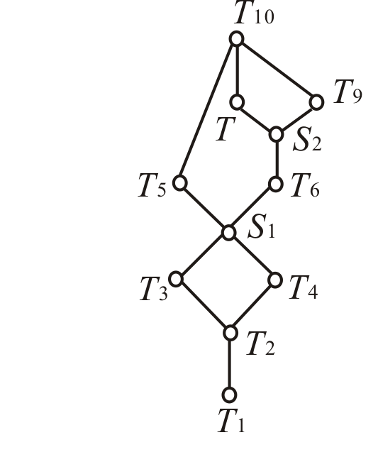
4.4.5 Partially Ordered Sets and Hasse Diagrams
⤷ Topological Sorting - Extending a Poset to a Total Order(e.g.)
Examle：A set of tasks A is given with partial order constraints, and its Hasse diagram is shown in the figure.
A = {T₁, T₂, T₃, T₄, T₅, S₁, T₆, S₂, T, T₉, T₁₀}
Check whether the following topological order is valid.
such as:
T₁, T₂, T₃, T₄, S₁, T₅, T₆, S₂, T, T₉, T₁₀；
T₁, T₂, T₃, T₄, S₁, T₆, S₂, T, T₉, T₅, T₁₀;

Slide 109
4.4 Equivalence Relations and Partial Order Relations•Brief summary
Objective :
Key Concepts ：

